Slide 1
TEMPOROMANDIBULAR
JOINT
Dr Sarath Babu V
Professor cum Principal
Dept. of Sports Physiotherapy
MGM Institute Of Physiotherapy
Chh. Sambhajinagar

Slide 2
The temporomandibular (TM) joint is unique in both structure and function.
Multiple bones merge to form the structure and contribute to the function of the TM joints.
These bones include the mandible, maxillae, temporal, zygomatic, sphenoid, and hyoid bones.
The proximal or stationary segment of the TM joint is the temporal bone.

Slide 3
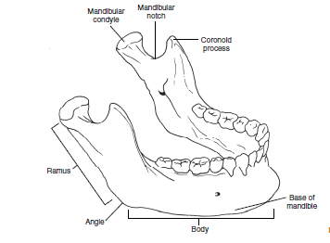
The mandible.

Slide 4
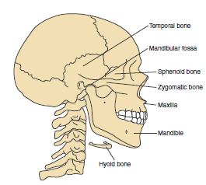
Lateral view of the mandible, maxilla, temporal bone, zygomatic bone, sphenoid bone, and hyoid bone.

Slide 5
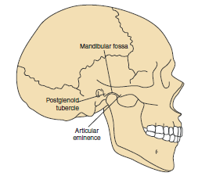
The bony composition of the temporomandibular joint

Slide 6
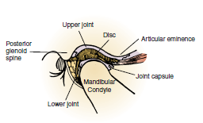
A cross-sectional lateral view of the TM joint shows the fibrocartilage-covered load-bearing surfaces on the condyle of the mandible and the articular eminence.
The TM disc divides the articulation into an upper joint and a lower joint, each with its own synovial lining.
The anterior and posterior attachments of the joint capsule to the disc are shown.

Slide 7
This is a synovial joint of condylar variety.
Articular surfaces-
A. upper part -
a) Articular eminence,
b) Ant. part of mandibular fossa.
B. inferior surface -
a) head of the mandible.

Slide 8
The name is derived from the two bones which form the joint : the upper temporal bone which is part of the cranium and the lower jaw bone called the mandible.

Slide 9
Components of the TMJ
Mandibular condyles
Articular surface of
the temporal bone
Capsule
Articular disc
Ligaments
Lateral pterygoid

Slide 10
Overall, the temporal bones and the mandible combine to create two separate yet connected TM joints.
The two TM joints are part of a closed chain and must function together

Slide 11
The articular surfaces of the articular eminence and the mandibular condyle are covered with dense, avascular, collagenous tissue that contains some cartilaginous cells.

Slide 12
The fibers near the surface of the articular covering are aligned in a parallel arrangement to facilitate gliding of the joint surfaces.
The presence of fibrocartilage rather than hyaline cartilage is significant because fibrocartilage can repair and remodel itself.

Slide 13
Typically fibrocartilage is present in areas that have to withstand repeated and high-level stress.
The TM joints are subjected to the repetitive stress of jaw motions as well as to tremendous bite forces, which have been measured at 597 N for women and 847 N for men.

Slide 14
The mandible is the largest of the facial bones and is highly mobile.
The mandible is arch-shaped and consists of a condyle at each posterior superior portion. Each mandibular condyle has a medial and lateral pole, and the lateral pole is readily palpable

Slide 15
Accessory Joint Structures
The incongruence of the TM joint is addressed by a unique articular disc.
The inferior TM joint is formed by the mandibular condyle and the inferior surface of the disc and functions as a simple hinge joint
The superior TM joint is larger than the inferior joint and is formed by the articular eminence of the temporal bone and the superior surface of the disc; it functions as a gliding joint.

Slide 16
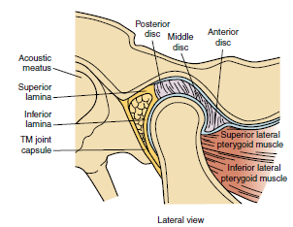
Articular Disc
A cross-section of the temporomandibular joint showing the articular disc.
The thickness of the disc varies from 2 mm anteriorly to 1 mm in the center to 3 mm posteriorly.

Slide 17
The purpose of the disc is to allow the convex surfaces of the articular eminence and the mandibular condyle to remain congruent throughout the range of motion of the TM joint in all planes.

Slide 18
Capsule and Ligaments
The elasticity of the joint capsule and ligaments determines the available motion at the TM joint in all planes

Slide 19
capsule
The capsule is a fibrous membrane that surrounds the joint and incorporates the articular eminence.
It attaches to the articular eminence, the articular disc and the neck of the mandibular condyle.
The portion of the capsule superior to the disc is quite lax, whereas the portion of the capsule inferior to the disc is taut.
Lack of capsular strength anteriorly predisposes anterior dislocation of mandibular condyle

Slide 20
The anterior portion of the disc attached to joint capsule & lateral pterygoid.This ant. Attachment restricts posterior translation.
The posterior portion attached to retrodiscal tissue superior & inferior lamina.
Sup. Lamina attached posteriorly at tympanic plate allows ant. Translation during mouth opening & repositioning due to its elastic property during mouth closing.
Inf. Lamina limits forward translation

Slide 21
Ligaments
The primary ligaments of the TM joint are the TM ligament, the stylomandibular ligament, and the sphenomandibular ligament.

Slide 22
TM ligament
The TM ligament is a strong ligament composed of two parts,
an outer oblique element and an inner horizontal element. .
The primary function of the TM ligament is to stabilize the lateral portion of the capsule.
Neither band of the TM ligament limits forward translation of the condyle or disc, but they do limit lateral Displacement.

Slide 23
The outer oblique element attaches to the neck of the condyle and the articular eminence
It serves as a suspensory ligament and limits downward and posterior motion of the mandible, as well as limiting rotation of the condyle during mandibular depression
The inner horizontal component of the ligament is attached to the lateral pole of the condyle and posterior portion of the disc and to the articular eminence.
Its fibers are aligned
horizontally to resist posterior motion of the condyle.
Limiting the posterior translation of the condyle protects the retrodiscal pad

Slide 24
stylomandibular ligament
The stylomandibular ligament is the weakest of the three ligaments and is considered a thickened part of the parotid sheath joining the styloid process to the angle of the mandible.
function of this ligament as limiting the protrusion of the mandible.

Slide 25
sphenomandibular ligament
The sphenomandibular ligament is described as the “strong” ligament that is the “swinging hinge” from which the mandible is suspended.
it serves to protect the mandible from excessive anterior translation.

Slide 26
The sphenomandibular ligament attaches to the spine of the sphenoid bone and to the middle surface of the ramus of the mandible.
sphenomandibular ligament also has continuity with the disc medially.
the sphenomandibular ligament serves as an accessory ligament and, in concert with the TM ligament, provides structural support for the TM joint.

Slide 27
Joint Kinematics
The TM joint is one of the most frequently used and mobile joints in the body.
It is engaged during mastication, swallowing, and speaking.
Most of the time, the TM joint movements occur without resistance from chewing or contact between the upper and lower teeth.
However, as a third-class lever, the TM joint is designed to maintain its structure in spite of significant forces acting on it.

Slide 28
Osteokinematic motions include
mandibular depression,
elevation,
protrusion,
retrusion,
left and right lateral excursions
Arthrokinematic movements involve
rolling,
anterior glide,
distraction,
lateral glide.

Slide 29
Depression- lateral pterygoid mainly
Elevation- masster,temporalis,medial petygoid of both sides.
Protrusion- lateral and medial pterygoid.
Retraction- posterior fibres of temporalis.
Lateral or side to side movement eg.turning chin to left side- left lateral pterygoid and right medial pterygoid.

Slide 30
To accomplish mandibular depression and elevation, the mandibular condyle must roll and glide.
During rotation, the mandibular condyle spins relative to the inferior surface of the disc in the lower joint .
Translation occurs in the upper joint between the disc and the articular eminence.

Slide 31
Depression(mouth opening) –
Normal mouth opening is done by Rotation in lower joint between disk & condyle with pure ant. Rotation of condyle on disk gliding or translation anteriorly & inferiorly in upper joint between disk & articular eminence.
Normal mandibular depression range of motion is
40 to 50 mm
Mastication requires approximately 18 mm of mandibular depression.

Slide 32
. Elevation (mouth closing)- reverse of depression post. Translation & post. Rotation
Mandibular elevation is the reverse of mandibular depression.
The mandibular condyle rotates posteriorly on the disc in the lower joint, and the condyle-disc complex translates posteriorly in the upper joint.

Slide 33
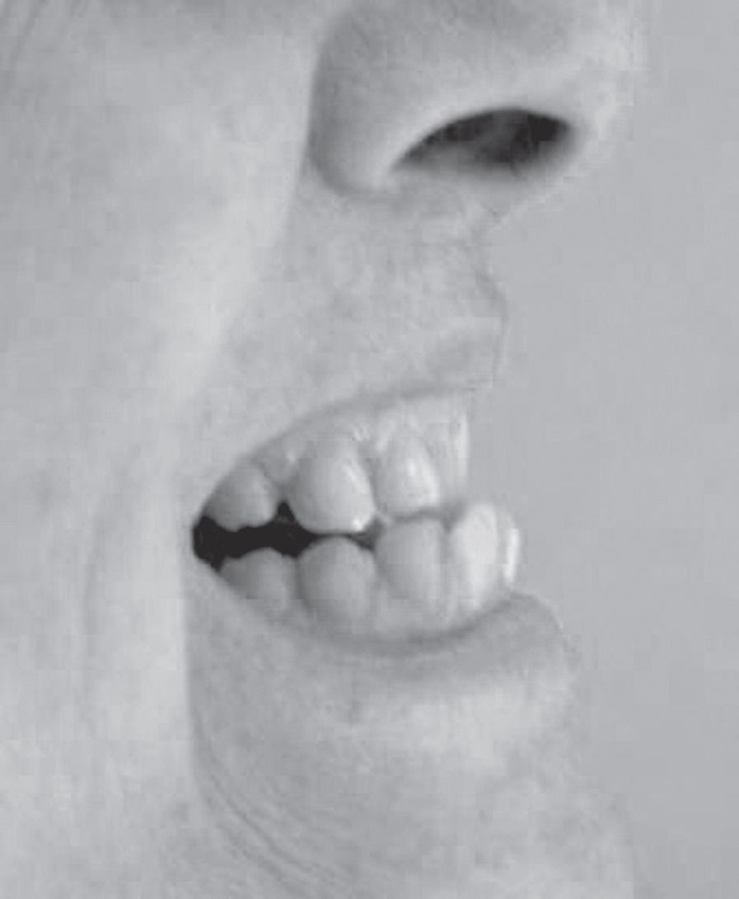
Mandibular Protrusion and Retrusion
Maximum mandibular protrusion, the lower teeth should be in front of the upper teeth.

Slide 34
Mandibular protrusion and retrusion occur in the upper TM joint.
The condyle-disc complex translates in an anterior inferior direction, following the downward slope of the articular eminence, during protrusion and returns along a posterior superior path.
Protrusion is an important component necessary for maximal mandibular depression.
Retrusion is an important component of mandibular elevation from a maximally depressed mandible..

Slide 35
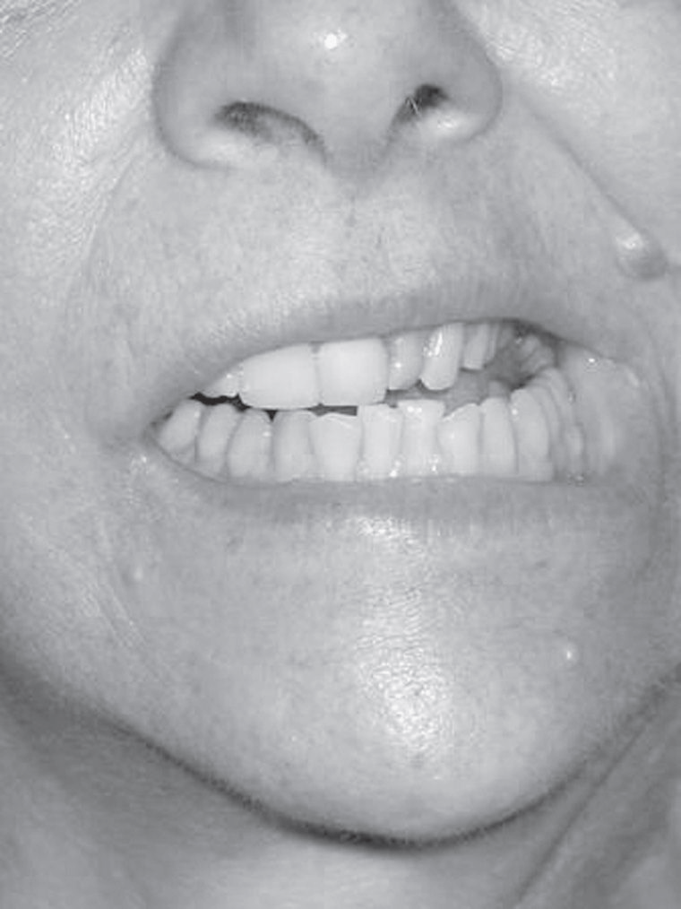
Mandibular Lateral Excursion
With normal lateral deviation of the mandible to the right, the midline of the lower teeth should move the full width of the right upper central incisor.

Slide 36
Lateral excursion involves moving the mandible to the left and to the right.
The degree of lateral excursion considered normal for an adult is 8 to 11 mm.

Slide 37
Muscles
The muscles acting on the TM joint are divided into primary and secondary muscle groups

Slide 38
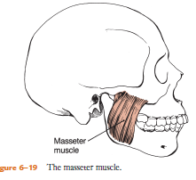
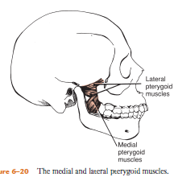
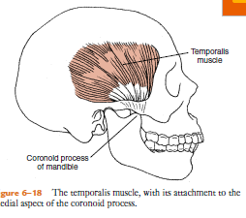
Primary Muscles
Temporalis
Masseter
Lateral pterygoid, and medial pterygoid.

Slide 39
Secondary Muscles
The secondary muscles are smaller than the primary muscles and consist of the suprahyoid and infrahyoid groups.
The digastric, geniohyoid, mylohyoid, and stylohyoid comprise the suprahyoid group

Slide 40
Coordinated Muscle Actions
Mandibular depression occurs from the concentric action of the bilateral digastric muscles in conjunction with the inferior portion of the lateral pterygoid muscles.
Mandibular elevation results from the collective concentric action of the bilateral masseter, temporalis, and medial pterygoid muscles.

Slide 41
The bilateral superior lateral pterygoid muscles eccentrically control the TM discs as the mandibular condyles relocate into the mandibular fossa with mandibular elevation.

Slide 42
The most common disorder of the TMJ is disc displacement.
The most common cause of TMJ pain is myofascial pain dysfunction syndrome, primarily involving the muscles of mastication.
Internal derangements is defined as an abnormal relationship of the disc to any of the other components of the TMJ. Disc displacement is an example of internal derangement

Slide 43
Degenerative joint disease, otherwise known as osteoarthritis is the organic degeneration of the articular surfaces within the TMJ.
TMJ pain remains one of the most reliable diagnostic criteria for temporal arthritis.

