Slide 1
Brunnstrom
Dr. Gaurav C. Mhaske
Dept. Of Neurophysiotherapy
MGM Institute Of Physiotherapy
Chh. Sambhajinagar

Slide 2
Objectives
Synergy and basic limb synergies in hemiplegia
Postural reflexes
Associated reactions
Principles
Motor tests for assessment

Slide 3
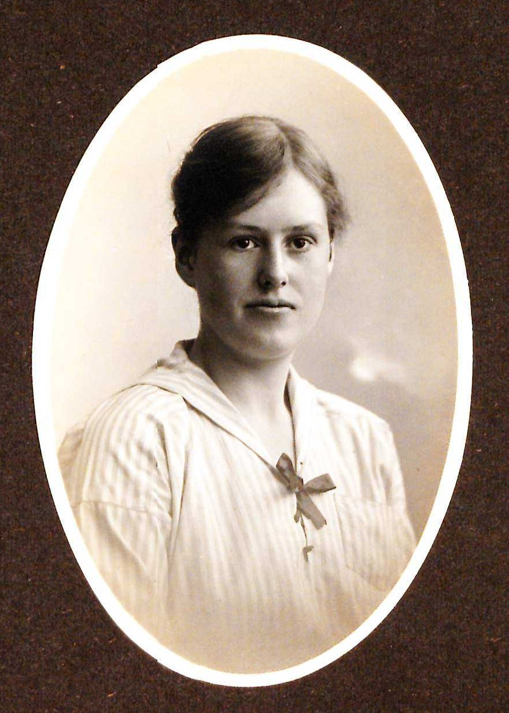
BACKGROUND
Signe Brunnstrom(1970 )
Swedish physiotherapist
Movement therapy
Rehabilitation in hemiplegia or hemiparesis

Slide 4
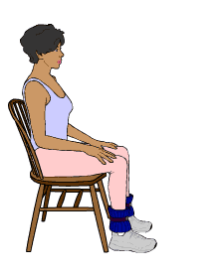
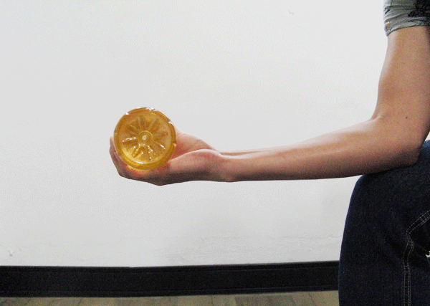
Synergistic motor behavior
Coupling together of muscles in an orderly fashion as a means by which purposeful movement is achieved with maximal precision and minimal waste of energy

Slide 5
Basic limb synergies
Stereotyped and does not permit combinations of muscles
Resulting movements are evoked volitionally or reflexively
Loss of inhibitory control by higher centers
Neurophysiologically muscles in the synergies are firmly linked together
Notes:
Sustained a CVA
Group of muscles in hemiplgic limb synergy :act as bound unit of motion prodeces same outcome irrespective of the attempt
They are primitive , automatic reflexive and highly similar
During early spastic period limb synergies make their appearance
Patients in hemiplegia are unable to recruit same muscles for diifernt combinations
beevor stated :muscle will be paralyzed for one movement but not for other
During spastic stage of hemi retain retain primitive sterotyped character as observed by sheerington and hagbarth

Slide 6
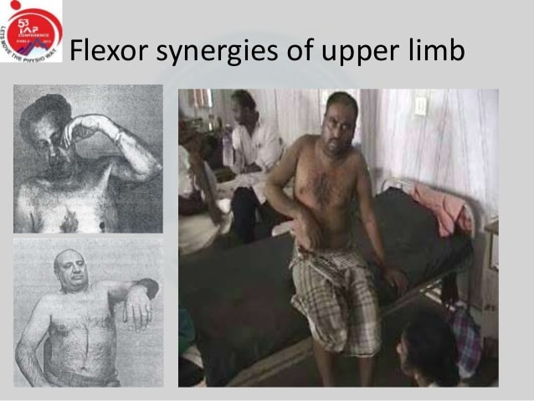
Flexor synergy of upper limb
Retraction and/elevation of scapular girdle
External rotation of the shoulder
Abduction of shoulder to 90 deg
Flexion of elbow to an acute angle
Supination of the forearm
Flexion of wrist and fingers
Notes:
Absence of supination due to tightness or spastic pronators

Slide 7
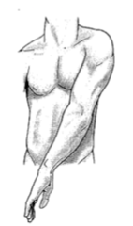
Extensor synergy of upper limb
Fixation of the shoulder girdle in a protracted position
Internal rotation of shoulder
Adduction of the arm in front of the body
Extension of elbow
Pronation of the forearm
Extension of wrist

Slide 8
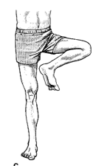
Flexor synergy of lower limb
Flexion of hip
Abduction and external rotation of hip
Flexion of knee to 90 deg
Dorsiflexion and inversion of the ankle
Dorsiflexion of the toes

Slide 9
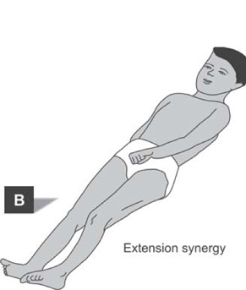
Extensor synergy of lower limb
Extension of hip
Adduction and internal rotation of hip
Extension of knee
Plantar flexion and inversion of ankle
Plantar flexion of the toes

Slide 10
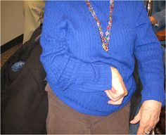
Typical arm posture
Elbow flexion
Shoulder Adduction
Forearm Pronation
Notes:
Interaction of synergy :relative strength of individual synergy component and manner in they interact
Involuntary
Lower limb :quadriceps and adductors in synergy to prevent knee buckling and weak abductors
Hip flexion and dorsiflexors

Slide 11
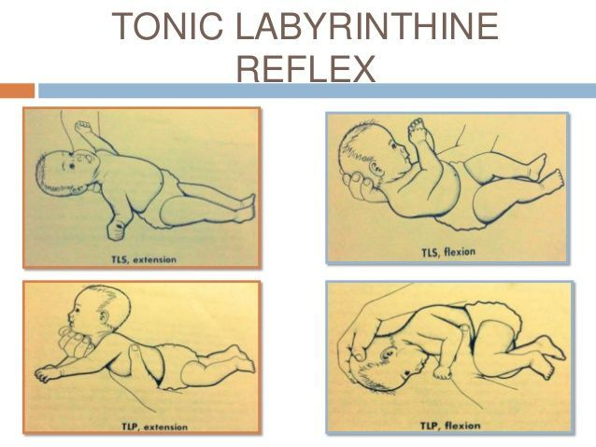
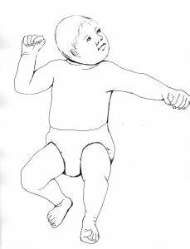
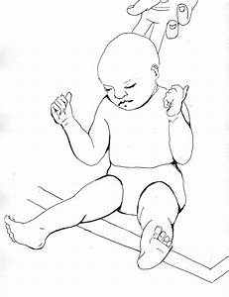
Postural reflexes
Tonic neck and labyrinthine reflexes
Magnus’s and Kleijn’s reflexes
Tonic lumbar reflexes
Notes:
Tonic lumbar reflex : changes in the position of upper part of the body with respect to the pelvis
Rotation of trunk to right :facilitate right upper limb flexion and right lower limb extension
Rotation to left :flexion of left upper limb and extension of right upper limb
Sports throwing

Slide 12
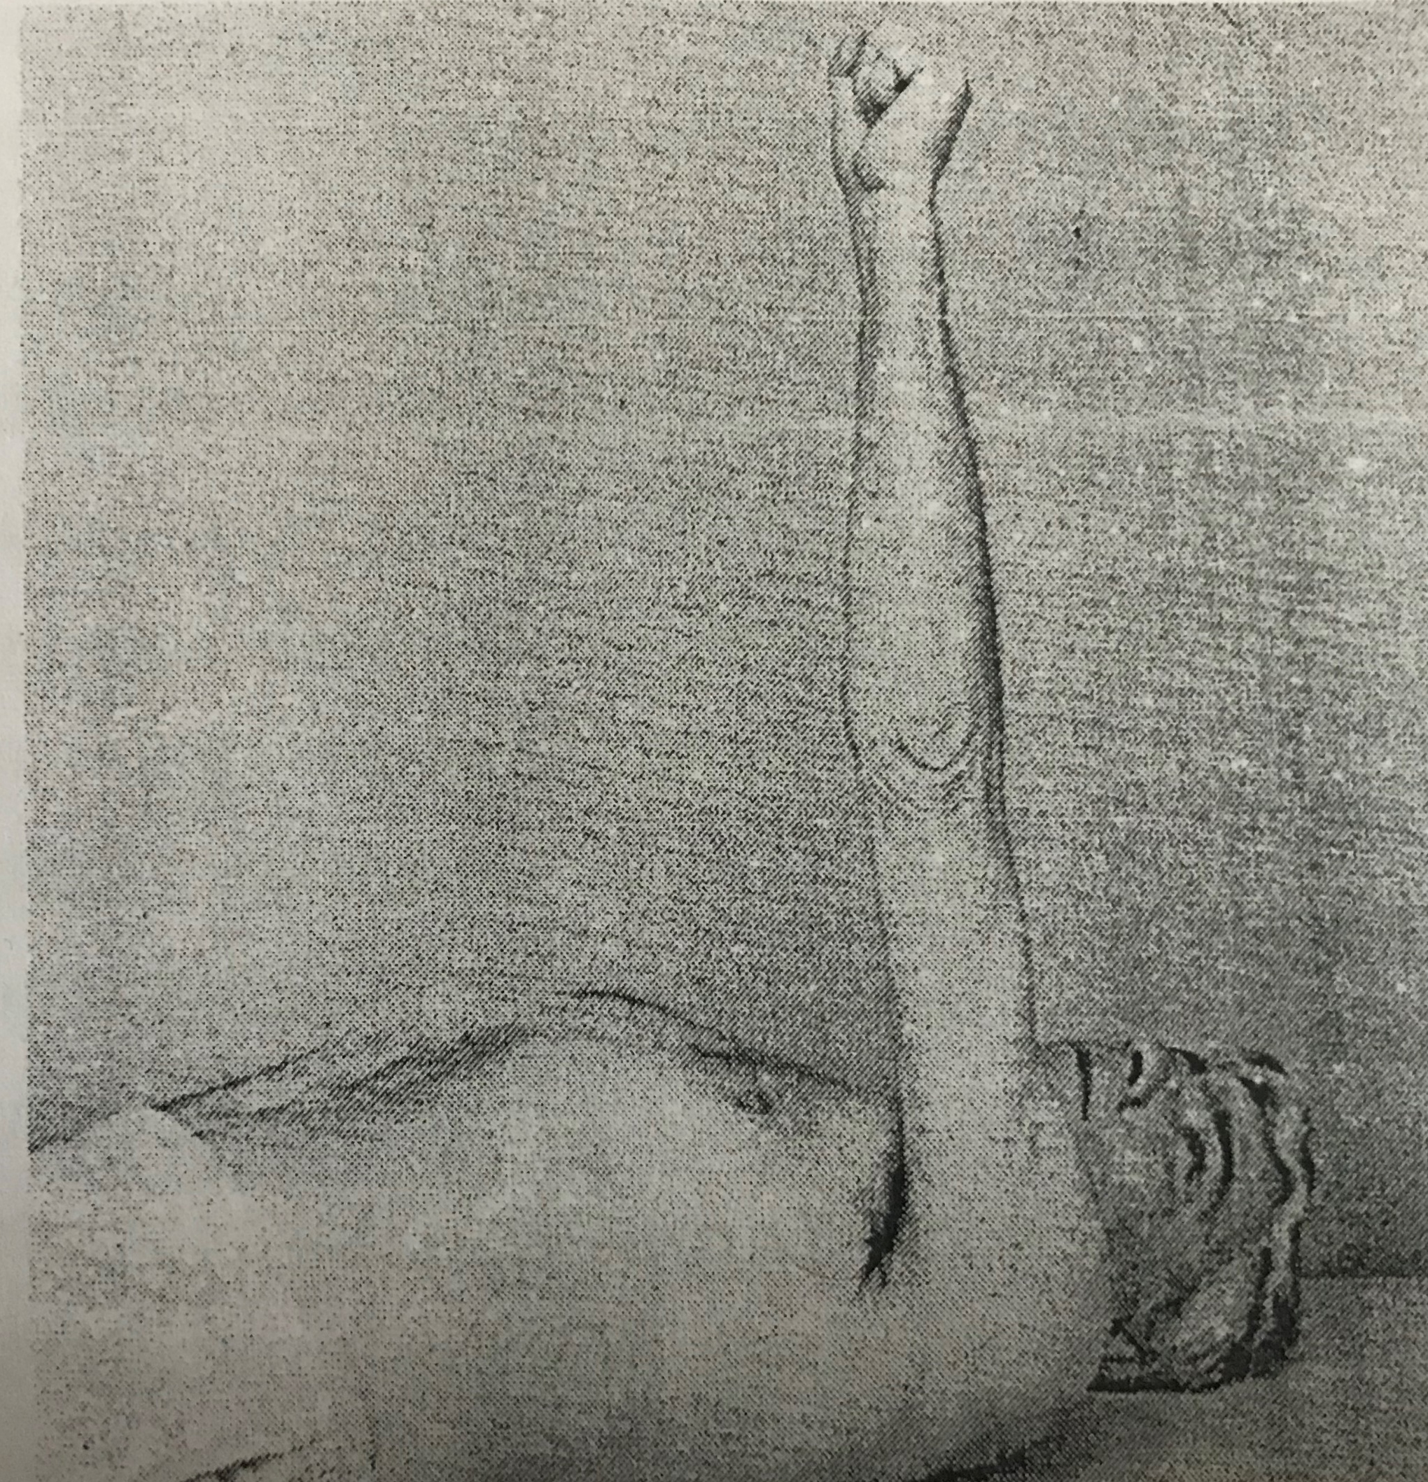
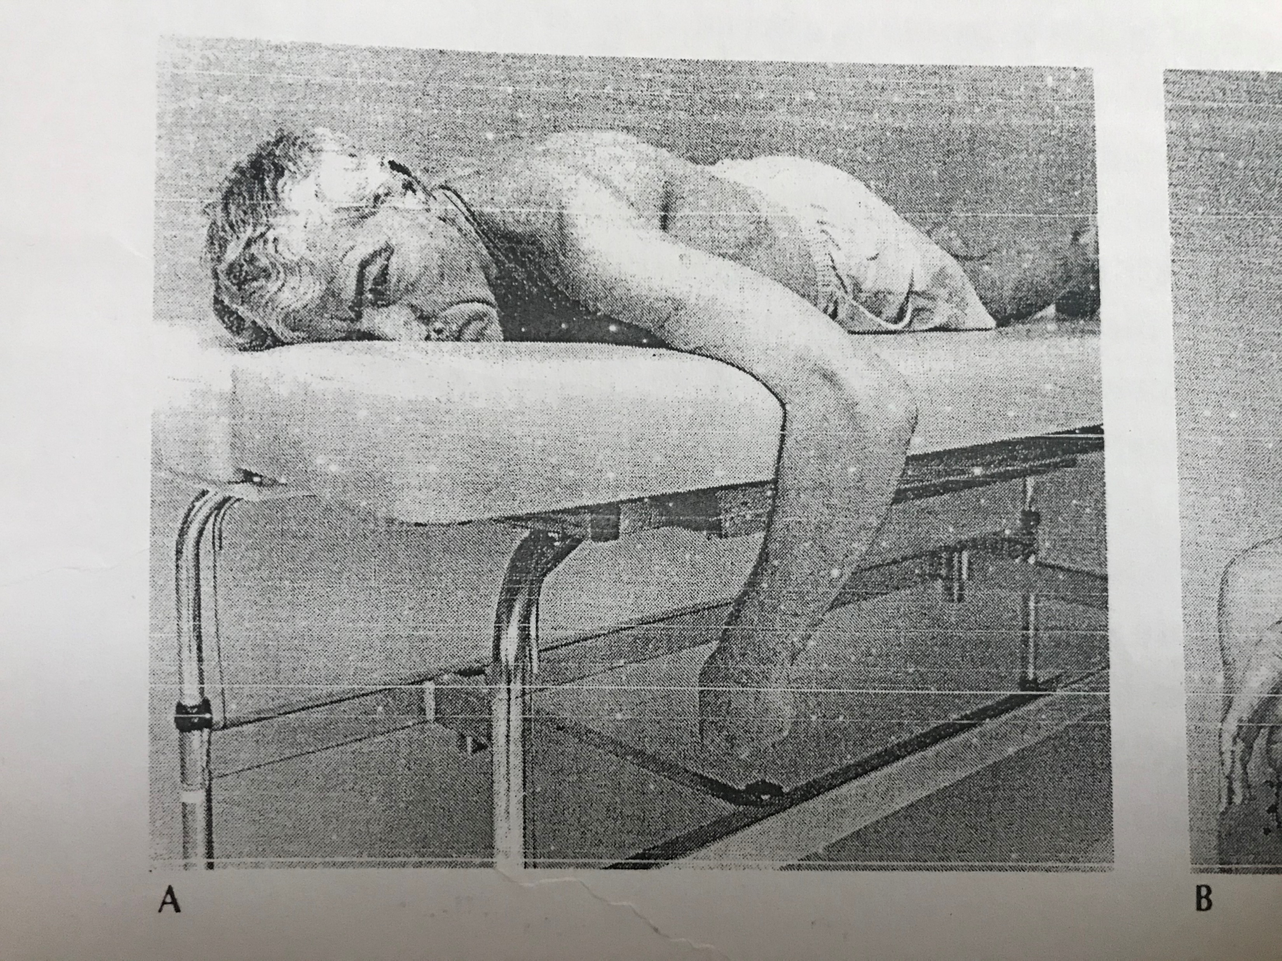
Influence of postural reflexes
Notes:
a.STNR:patient unable to extend the upper extremity elbow
Elbow extension possible in supine
Inhibitory effect ob prone and facilitatiry on supine
Receptors on the skin

Slide 13
Associated reactions
“Automatic activities which fix or alter the posture of a part or parts when some other part of the body is brought into action by either voluntary effort or reflex stimulation’’
CONCLUSIONS MADE BY BRUNNSTROM
Essentially flaccid
Under variety of different conditions
Years after onset of hemiplegia
Repeated stimuli
Tension in the muscles decrease rapidly after cessation of the stimulus
Attitudinal reflex affect the reactions
Notes:
Posural adjustmnets are required for purposeful movement carried out by reflexive mechanism ,no longer adapt to individual needs
They are released postural reactions deprived of voluntary control
2.In presence of spasticity ,achieved degree of voluntary control
3.

Slide 14
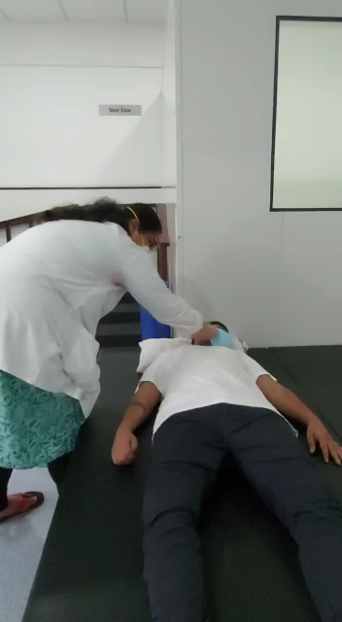
Associated reactions
Notes:
Posural adjustmnets are required for purposeful movement carried out by reflexive mechanism ,no longer adapt to individual needs
They are released postural reactions deprived of voluntary control
2.In presence of spasticity ,achieved degree of voluntary control
3.

Slide 15
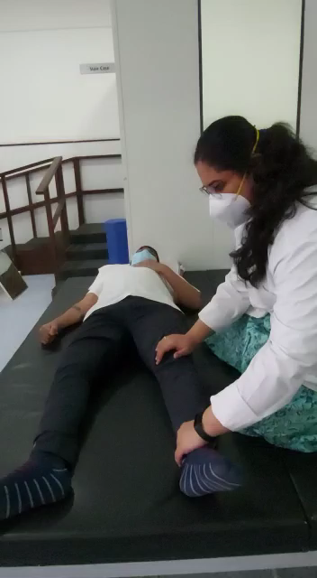
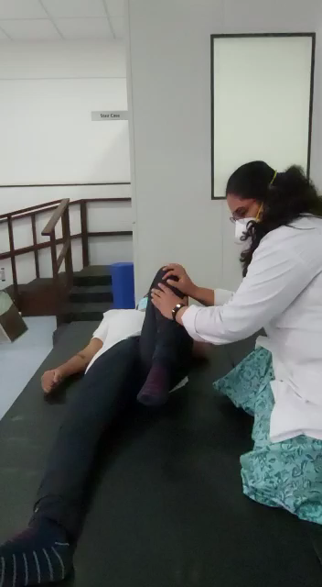
Associated reactions IN LOWER LIMBS
Notes:
Posural adjustmnets are required for purposeful movement carried out by reflexive mechanism ,no longer adapt to individual needs
They are released postural reactions deprived of voluntary control
2.In presence of spasticity ,achieved degree of voluntary control
3.

Slide 16
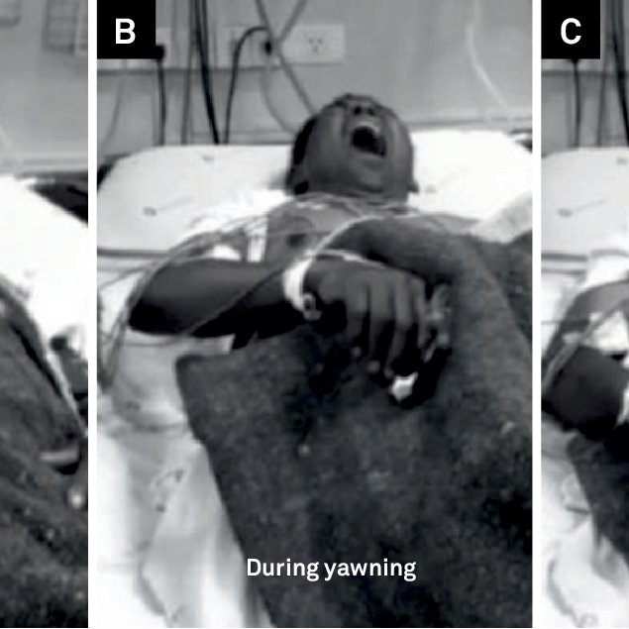
Associated reactions evoked by yawning, sneezing, and coughing
Notes:
Flexion synergy in the inhalation phase of yawn
Morning stretch :arm flexion with opening of hands

Slide 17
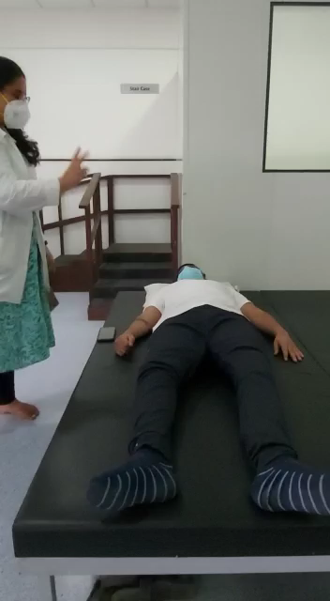
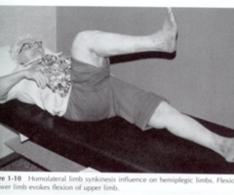
Homolateral limb synkinesis
Notes:
Mutual dependency of upper limb and lower limb
Homolateral pattern develops than crossed pattern thus evolution in reverse

Slide 18
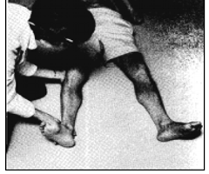
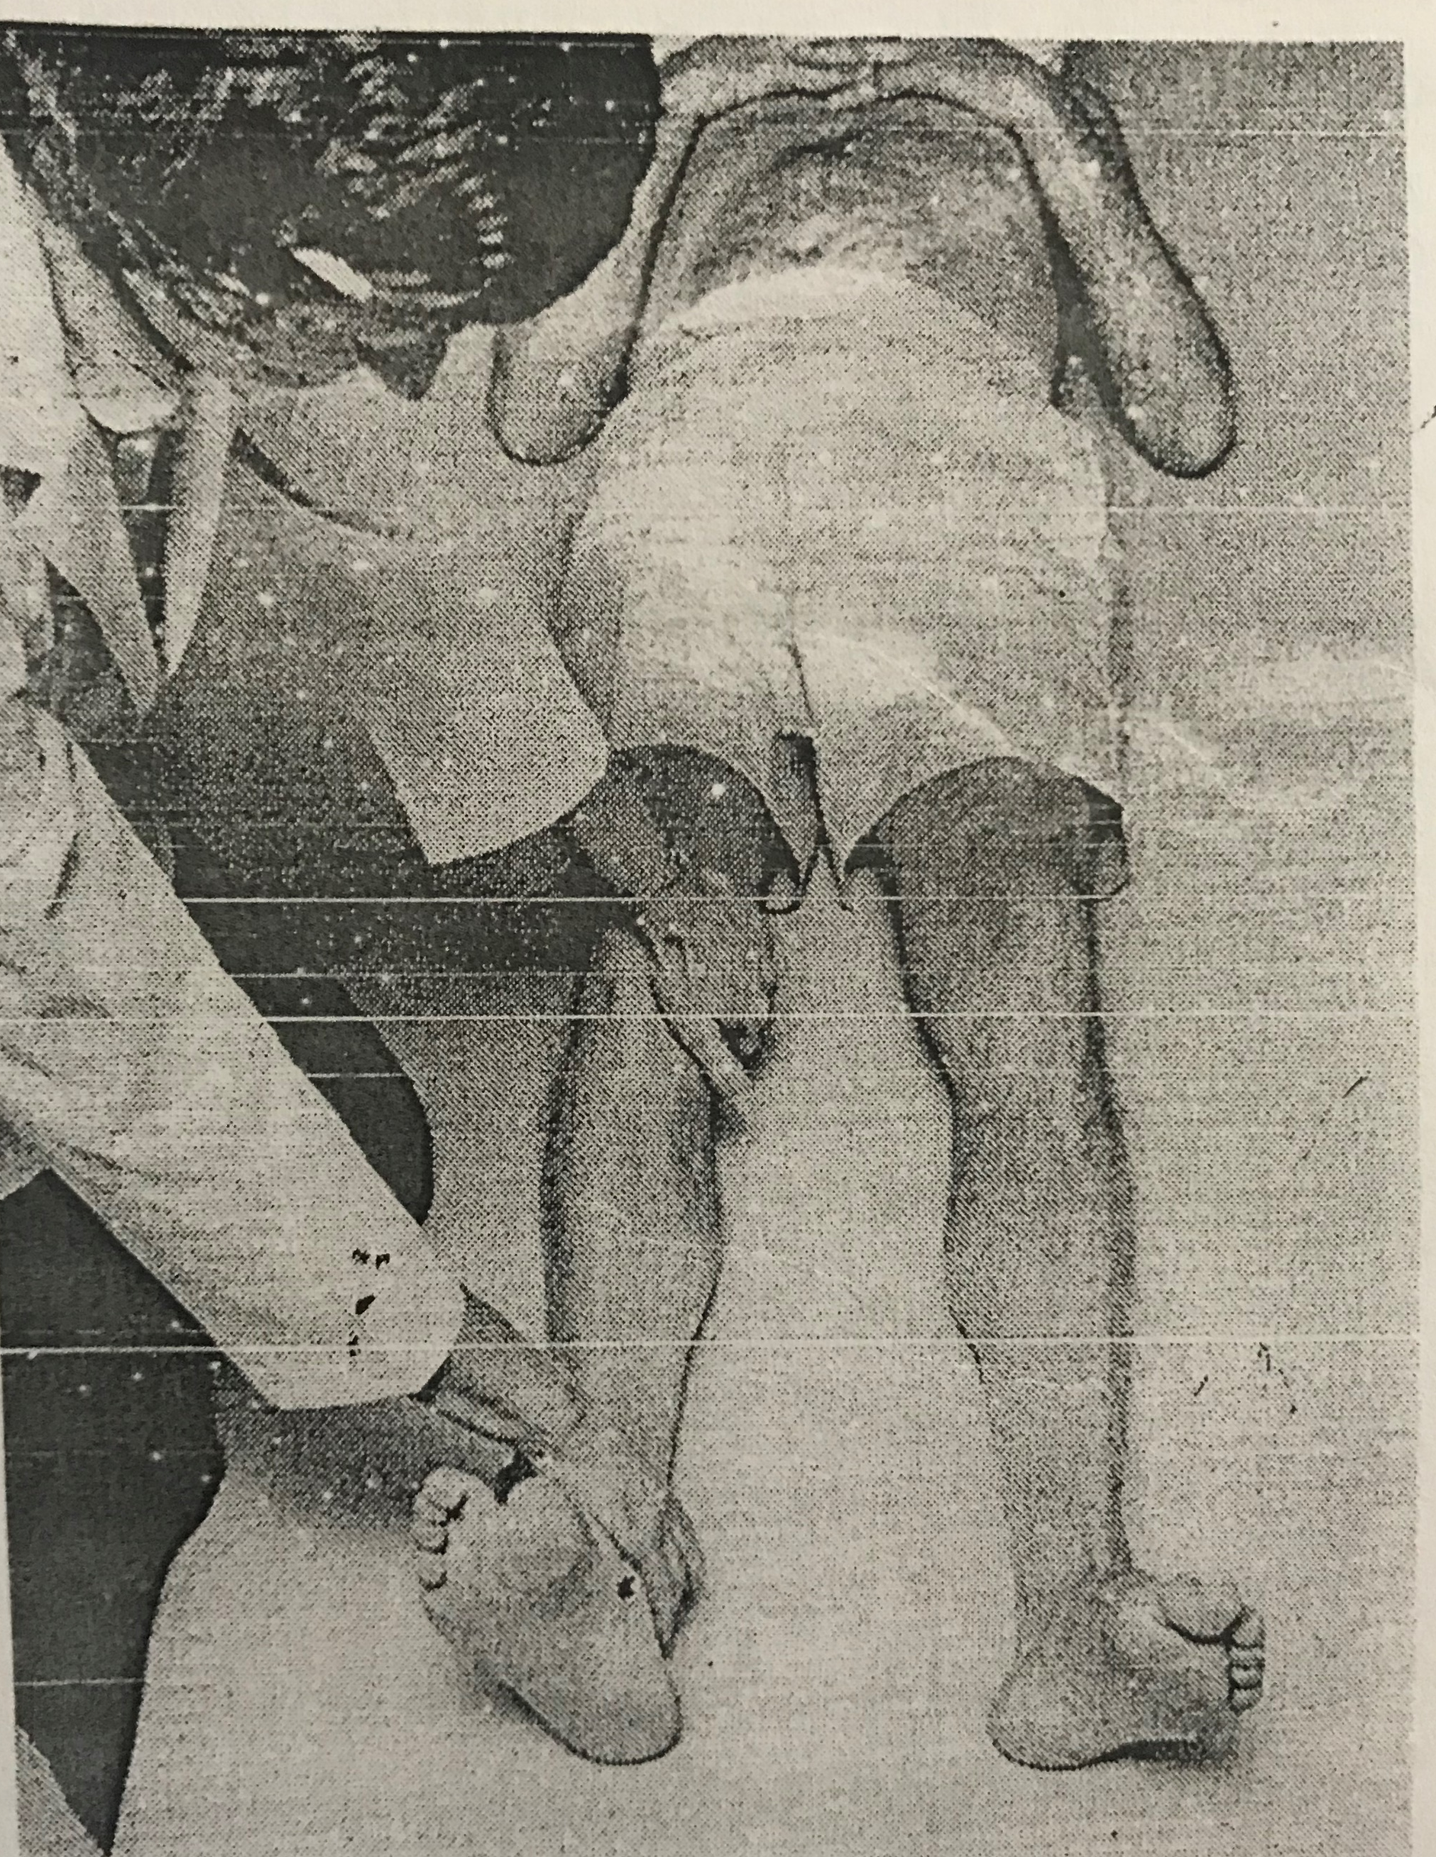
Raimiste’s phenomenon
Abduction phenomenon
Adduction phenomenon
Notes:
Organic hemiplegia
Adduction easy and before abduction(extensor synergy )
Inherent symmetrical movements exaggerated in hemi
Coordination synkinesis

Slide 19
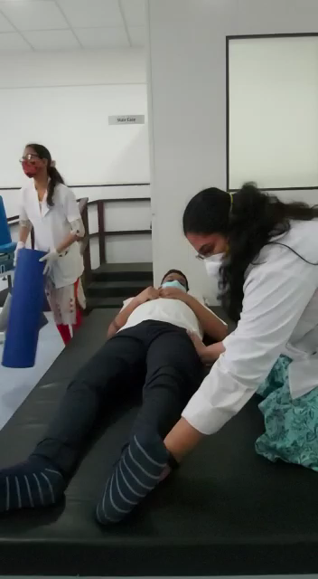
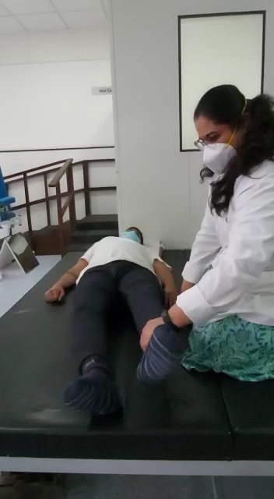
Raimiste’s phenomenon
Abduction phenomenon
Adduction phenomenon
Notes:
Organic hemiplegia
Adduction easy and before abduction(extensor synergy )
Inherent symmetrical movements exaggerated in hemi
Coordination synkinesis

Slide 20
Hand reactions
Proprioceptive traction response
Stretch to flexor muscle of one joint
Flexor response of all the other joints
Tonic neck reflex
Body righting reactions.
Notes:
Evolution of grasping function simple stretch reflex a spinal cord reaction
Body righting flexion of upper most extremity and extension of lower (facilitated when affected extremity is on upper side )

Slide 21
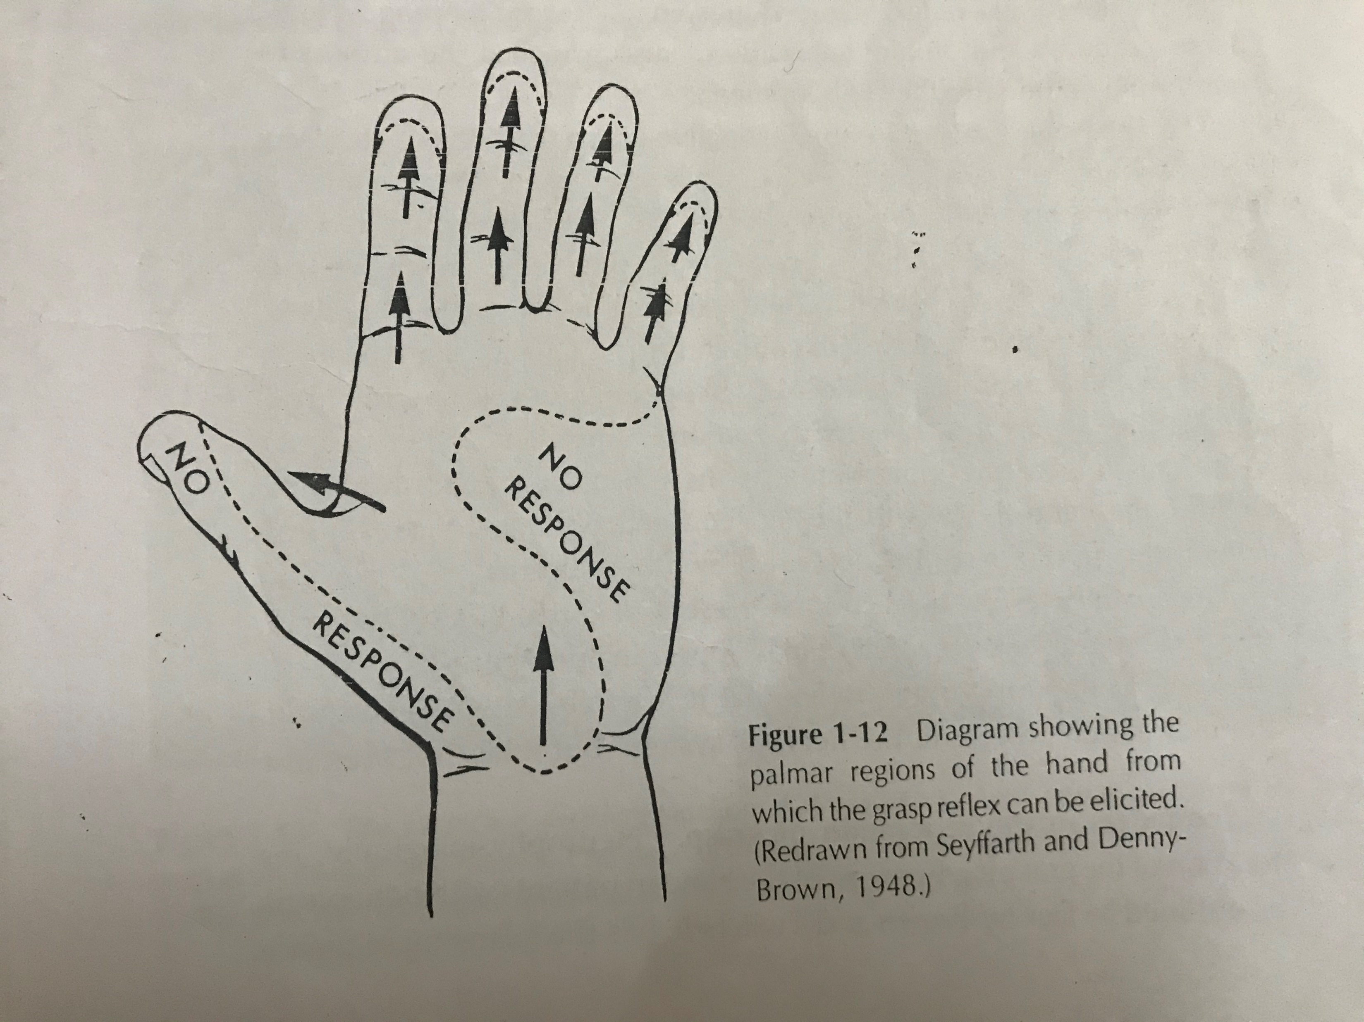
True grasp reflex
Flexion of joint or joint over which the stimulus moves
Grasp reflex: catching phase
holding phase
Notes:
Moving stmuli
Catching phase: weak contraction of flexor and adductor
Holding:stretch on the tendons of the muscles

Slide 22
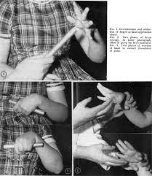
Instinctive grasp reaction
Instinctive avoiding reaction
Notes:
Stationary contact
Voluntary closure unable to open the
Withou the object no difficulty I opening and closing of hand
Frontal lobe
Avoiding ;lesion of parietal lobe
MTP extension on stimulus on palm distally
Grasp is possible but with hesitation
And more concentration required
Reaction is antagonistic to voluntary grasp reaction

Slide 23
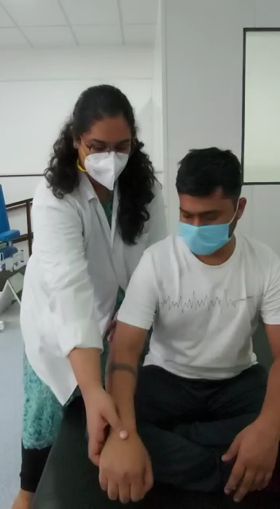
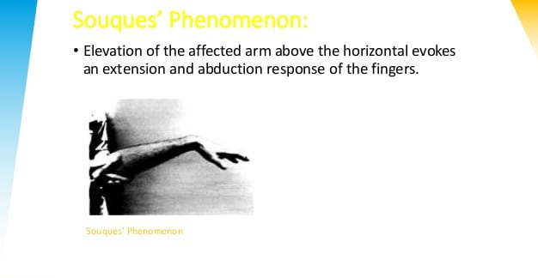
Souques’s phenomenon
Passive elevation of the hemiplegic upper limb to 90 degrees of shoulder flexion → Extension of fingers

Slide 24
Principles of evaluation
1.Based on typical recovery stages of the patients as an indication of the approximate extent of the recovery of CNS
2.Brief and easy to administer
3.Avoid complicated equipment ,yet function with considerable amount of objectivity
4.Standardized and administered by personnel familiar with the motor behavior of patients with hemiplegia
Notes:
Assessment of degree of recovery of CNS should ne made
Not to overly fatigue the patient
Cannot be assesd by mmt as the individual movements are not possible till spasticity is present

Slide 25
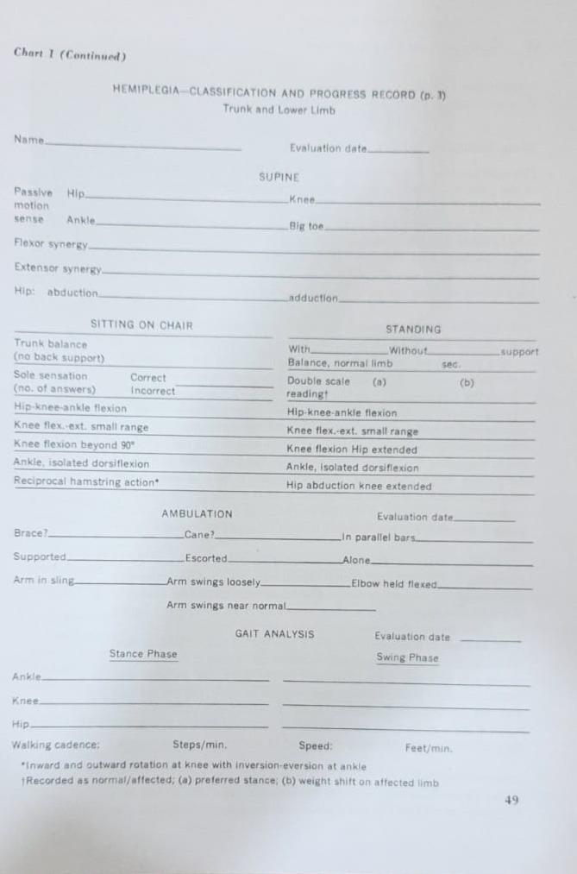
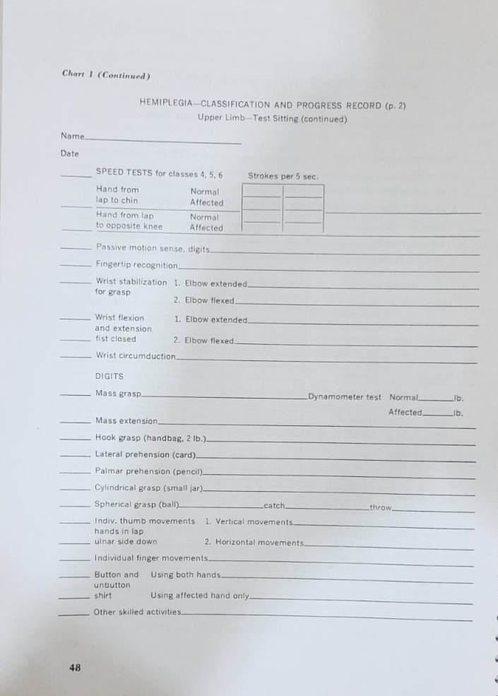

Slide 26
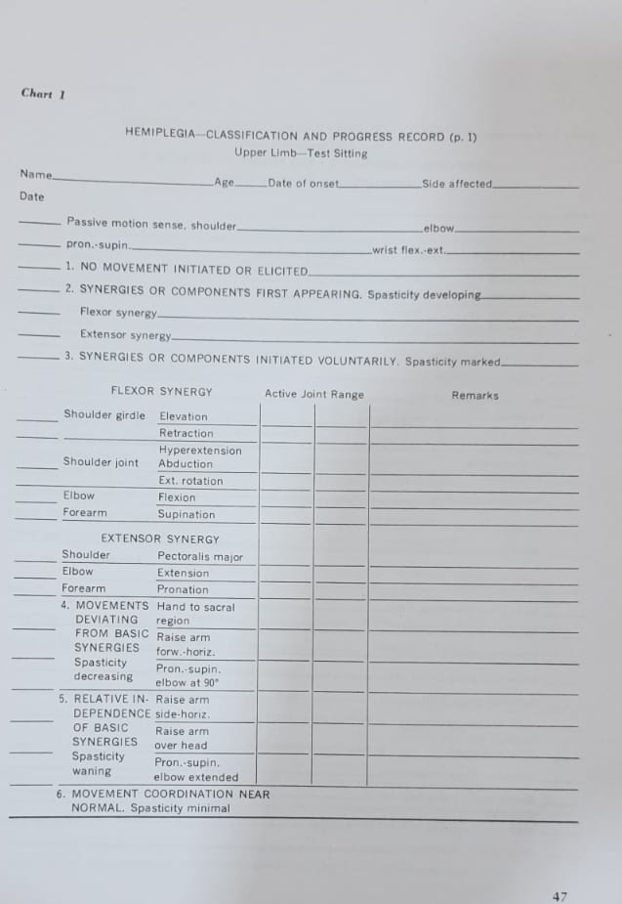

Slide 27
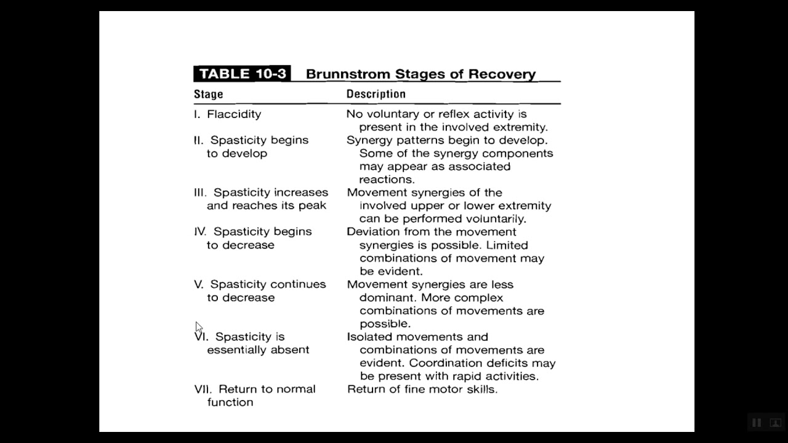
Recovery stages of brunnstrom

Slide 28
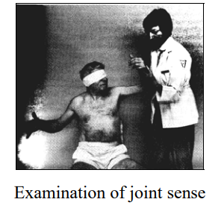
SENSORY EVALUATION of brunnstrom
Joint sense:
With the patient seated and is blindfolded; the affected upper limb is supported by the examiner and moved to different positions asking the patient to perform identical position with the unaffected extremity.

Slide 29
SENSORY EVALUATION of brunnstrom
Touch sensation:
The palmer aspect of the finger tips are touched with a rubber end of a pencil and the patient is asked to determine without looking which fingertip is touched.
Sole sensation:
The patient, without looking, is asked to determine if an object is touching and pressing against his sole of the foot or not and where.

Slide 30
Motor test for shoulder and elbow
Stage 1:
Stage 2
Stage 3
no voluntary movement
no muscular resistance to movement can be detected
basic limb synergies or some their components make their appearance
basic limb synergies or some their components are performed voluntarily
spasticity increased

Slide 31
Stage 4
Stage 5
Stage 6
placing hand behind the body;
elevation of arm to forward horizontal position ;
pronation-supination with elbows at 90 deg
arm raising to side horizontal position ;
arm raising forward and overhead ;
pronation and supination with elbow extended
isolated joint movements freely performed ;
movements are well coordinated and appears normal ;
speed tests ; chin to knee and one knee to another knee

Slide 32
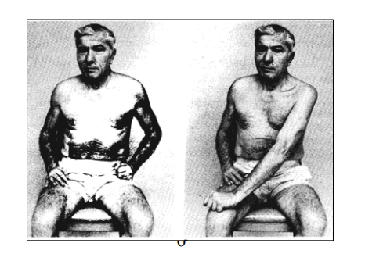
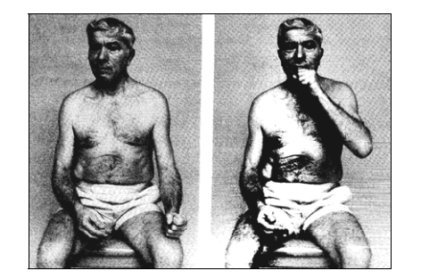
SPEED TEST

Slide 33
Motor test for Hand
Stage 1
Flaccidity
Stage 2
Little or no activity finger flexion
Stage 3:
mass grasp
use of hook grasp but no release
no voluntary finger extension
possibly reflex extension of digits

Slide 34
Stage 4 :
lateral prehension
Stage 5
Stage 6
All prehensions types under control
release by thumb movement
semivolunatry finger extension
small range
palmar prehension possibly cylindrical and spherical grasp
awkwardly performed and with limited functional use
voluntary mass extension of digits
variable range
skills improving less accurate than on opposite side

Slide 35
Motor test for trunk and limb
Stage 1
Stage 2:
Stage 3 :
flaccidity
minimal voluntary movements of the lower limb
hip knee ankle flexion in sitting and standing

Slide 36
Stage 4
Stage 5
Stage 6
sitting -knee flexion beyond 90 deg with foot sliding backward on the floor
voluntary dorsiflexion of the ankle without lifting the foot off the floor
standing ,isolated non weight bearing knee flexion ,hip extended or nearly extended
standing ,hip abduction beyond range obtained from elevation of the pelvis ;
standing -isolated dorsiflexion of the ankle ,knee extended ,heel forward in a position of short step
reciprocal activation of the inner and outer hamstring muscles ,
combined inversion and eversion of the ankle

Slide 37
FUGYL MEYER ASSESSMENT
Also known as Brunnstrom Fugyl Meyer Motor Function Assessment
Defines 50 details of movement across six levels of recovery
Ordinal scoring system where 0 indicates cannot be performed; 1, can be partly performed; 2 can be performed faultlessly
1520603_fma-ue-protocol-english-updated-20150311.pdf
Fugl-Meyer_Assessment_Lower-Extremity_FMA-LE.pdf

Slide 38
In light of motor control
Systems theory
Brunnstroms approach
synergy
Kuyper’s model
Reflex model
Notes:
Synergy :linkage of all muscles into functional unit
As the cns links all muscles into functional patterns
Systems theory :computer :basics feedback
Feedbck processs fundamental to the systems theory imply the role of ns beyond passage og impulses
Info being exchanged amon the elements of the ns
Reflex :sensory to motor transmission of impulse cns acts as a mere transmission
Kuypers model :dispers control among variety of brain centres
Clinically explaining the phenomenon of LE synergy pattern and upper limb dissociated activities

Slide 39
Principles of treatment
1.Treatment must progress developmentally
Reflex response control of voluntary movement automatic functional behavior
2.No motion: facilitate using reflexes, associated reactions proprioceptive and exteroceptive facilitation to develop muscle tension
3.Voluntary response : isometric eccentric concentric.
4.Partial movement :Stress reversal of movement
5.Reduce or drop out facilitation as quickly as patient shows evidence of volitional control
6.Emphasis on willed movements
7.Repeat correct movement and practice functional activities.
Reference :Trombly occupational therapy
Notes:
Use of lumbar reflex
Sensori feedback associated with the movement and satisfaction of movment occurring voluntarily at some degree
Proprioceptive stimuli :resistance :spread of impulse to produce patterned response(associated reactions)
Extero :tactile stimuli:localized area
Eccentric :generate more force and use less energy
Stimuli which are stereotypically bound to the response are dropped first and tactile stimuli will be dropped last
6. To overcome the linkages between the synergies ,more success if familiar movement s are done
7.Relate the sensation to goal directed activities

Slide 40
References
Brunnstrom S. Movement therapy in hemiplegia. A neurophysiological approach. 1970:113-22.
Radomski MV, Latham CA, editors. Occupational therapy for physical dysfunction. Lippincott Williams & Wilkins; 2008.

