Slide 1
FARADIC CURRENT
Dr. Gaurav C. Mhaske
Dept. Of Neurophysiotherapy
MGM Institute Of Physiotherapy
Chh. Sambhajinagar

Slide 2
Learning Objectives:
The lecture aims to brief students about the following:
Nature of faradic currents.
Therapeutic & Physiological effects of faradic currents.
Techniques of application.
Indication & Contraindication.
Clinical applications of faradic currents.
Precaution & Dangers

Slide 3
Learning Outcomes:
Successful student therapist will be able to explain about the following:
1.Explain about accommodation
2.Explain about the nature of faradic currents
3.Explain about the therapeutic and physiological effects
4.Techniques of application
5.Clinical applications of faradic currents.

Slide 4
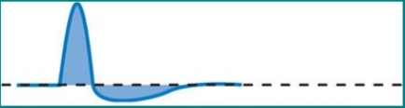
Definition
It is a short-duration interrupted current, with a pulse duration ranging from 0.1 and 1 ms and a frequency of 50 to 100 Hz. Its called Farradism which is a type of induction coil. The wave form is as follows;
Wave forms:
Induced asymmetrical alternating
current.
2. Biphasic, Asymmetrical,
Unbalanced, Spiked.
3. Positive portion- short duration, high
amplitude and
spiked.
4. Negative portion- long duration, low
amplitude and
curved

Slide 5
Modifications
Faradic currents are always surged for treatment purposes to produce a near normal tetanic-like contraction and relaxation of muscle.
Current surging means the gradual increase and decrease of the peak intensity.

Slide 6
Forms of faradic current
Each represents one impulse:
* In surged currents, the intensity of the successive impulses increases gradually, each impulse reaching a peak value greater than the preceding one then falls either suddenly or gradually.
* Surges can be adjusted from 2 to 5-second surge, continuously or by regularly selecting frequencies from 6 to 30 surges / minute.
* Rest period (pause duration) should be at least 2 to 3 times as long as that of the pulse to give the muscle the sufficient time to recover (regain its normal state).

Slide 7
Forms of faradic current
The most comfortable pulse is either 0.1-msec pulse, with a frequency of 70 Hz or 1-msec pulse with a frequency of 50 Hz.
For practically all skeletal muscles, tetanic contraction requires a minimum frequency of 7 Hz. Lower frequencies result in separate contractions.
The most comfortable tetanic contractions are obtained with frequencies between 40 and 80 Hz

Slide 8
Effects of faradic currents
Stimulation of sensory nerves:
It is not very marked because of the short duration.
It causes reflex vasodilatation of the superficial blood vessels leading to slight erythema.
The vasodilatation occurs only in the superficial tissues.

Slide 9
2. Stimulation of the motor nerves:
It occurs if the current is of a sufficient intensity, causing contraction of the muscles supplied by the nerve distal to the point of stimulus.
A suitable faradic current applied to the muscle elicits a contraction of the muscle itself and may also spread to the neighboring muscles.
The character of the response varies with the nature and strength of the stimulus employed and the normal or pathological state of muscle and nerve.

Slide 10
2. Stimulation of the motor nerves:
The contraction is tetanic in type because the stimulus is repeated 50 times or more / sec.
If this type is maintained for more than a short time, muscle fatigue occurs.
So, the current is commonly surged to allow for muscle relaxation i.e. “when the current is surged, the contraction gradually increases and decreases in strength in a manner similar to voluntary contraction”.

Slide 11
3. Stimulation of the nerve is due to producing a change in the semi-permeability of the cell membrane:
This is achieved by altering the resting membrane potential.
When it reaches a critical excitatory level, the muscle supplied by this nerve is activated to contract.

Slide 12
4. Faradic currents will not stimulate denervated muscle:
The nerve supply to the muscle being treated must be intact because the intensity of current needed to depolarize the muscle membrane is too great to be comfortably tolerated by the patient in the absence of the nerve.

Slide 13
5. Reduction of swelling and pain:
It occurs due to alteration of the permeability of the cell membrane, leading to acceleration of fluid movement in the swollen tissue and arterial dilatation.
Moreover, it leads to increase metabolism and get red of waste products.

Slide 14
6. Chemical changes:
The ions move one way during one phase of the current; and in the reverse direction during the other phase of the current if it is alternating.
If the two phases are equal, the chemicals formed during one phase are neutralized during the next phase.
In faradic current, chemical formation should not be great enough to give rise to a serious danger of burns because of the short duration of impulses.

Slide 15
Application of faradic current
Muscle stimulation with faradic current the muscle must have a good general innervation.
The current may be applied for both diagnostic and therapeutic objectives.

Slide 16
Diagnostic objectives
Investigation of myasthenic reaction;
Investigation of myotonic reaction;
Localization of a neurapraxia(nerve compression) block.

Slide 17
Indications:
Facilitation of muscle contraction inhibited by pain:
Stimulation must be stopped when good voluntary
contraction is obtained.
2. Muscle re-education:
Muscle contraction is needed to restore the sense of
movement in cases of prolonged disuse or incorrect
use; and in muscle transplantation.
The brain appreciates movement not muscle actions,
so the current should be applied to cause the
movement that the patient is unable to perform
voluntarily.

Slide 18
3. Training a new muscle action:
After tendon transplantation, muscle may be required to perform a different action from that previously carried out. With stimulation by faradic current, the patient must concentrate with the new action and assist with voluntary contraction.

Slide 19
4. Nerve damage:
When a nerve is severed, degeneration of the axons takes place after several days.
So, for a few days after the injury, the muscle contraction may be obtained with faradic current.
It should be used to exercise the muscle as long as a good response is present but must be replaced by modified direct current as soon as the response begins to weaken.

Slide 20
5. Improvement of venous and lymphatic drainage:
In oedema and gravitational ulcers, the venous and lymphatic return should be encouraged by the pumping action of the alternate muscle contraction and relaxation.

Slide 21
6. Prevention and loosening of adhesions:
After effusion, adhesions are liable to form, which can be prevented by keeping structures moving with respect to each other.
Formed adhesions may be stretched and loosened by muscle contraction.

Slide 22
7. Painful knee syndromes:
After trauma, there is inhibition of muscle contraction, leading to muscle atrophy.

Slide 23
Contraindications:
Skin lesions: The current collects at that point causing pain.
Certain dermatological conditions: Such as psoriasis, tinea
and eczema.
Acute infections and inflammations.
Thrombosis.
Loss of sensation.
Cancer.
Cardiac pacemakers.
Superficial metals.

Slide 24
Methods of Application
Unipolar
Bipolar

Slide 25
Technique of Application
Group muscle stimulation; and
Motor Point stimulation.

Slide 26
Group Muscle Stimulation
Stationary stimulation
Active electrode & Passive electrode will be kept stationary

Slide 27


Slide 28
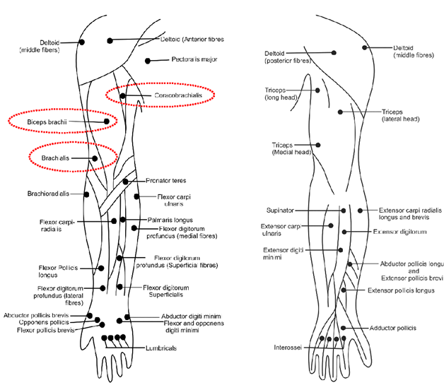

Slide 30
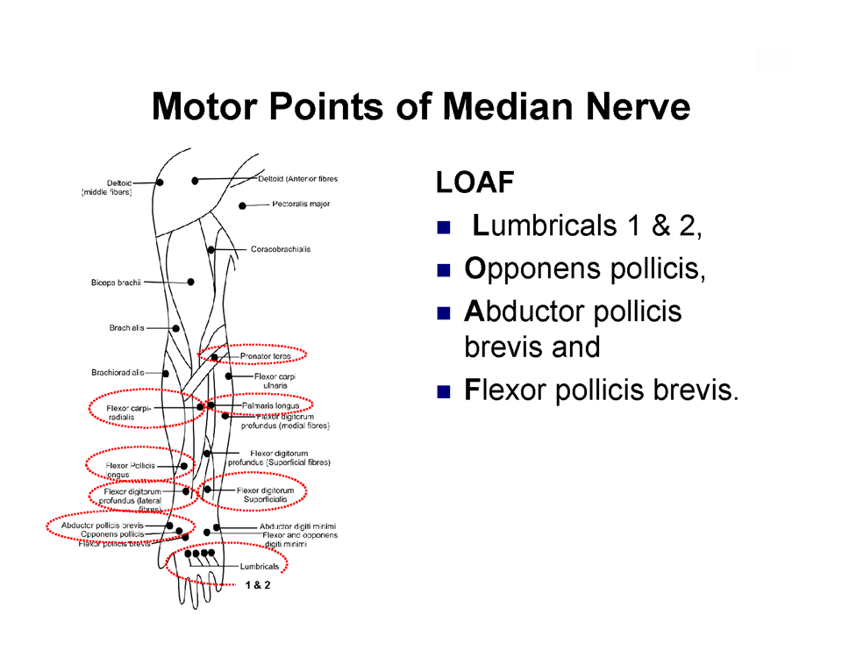

Slide 31
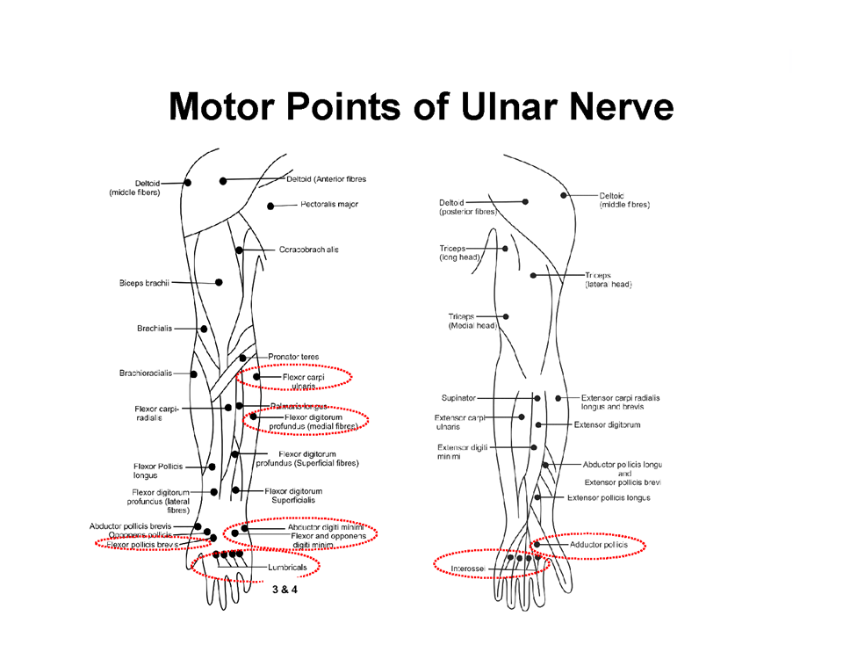

Slide 32
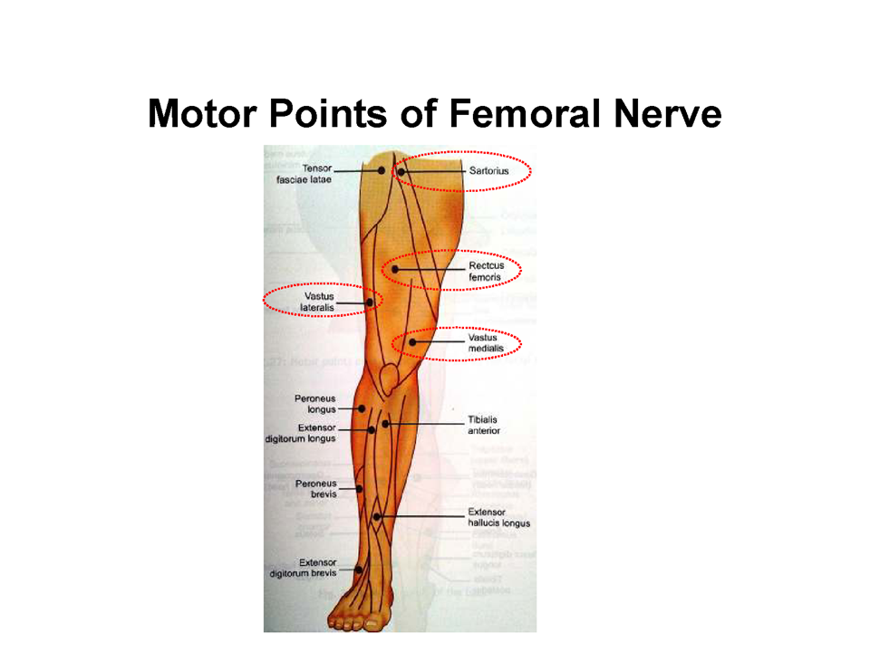

Slide 33
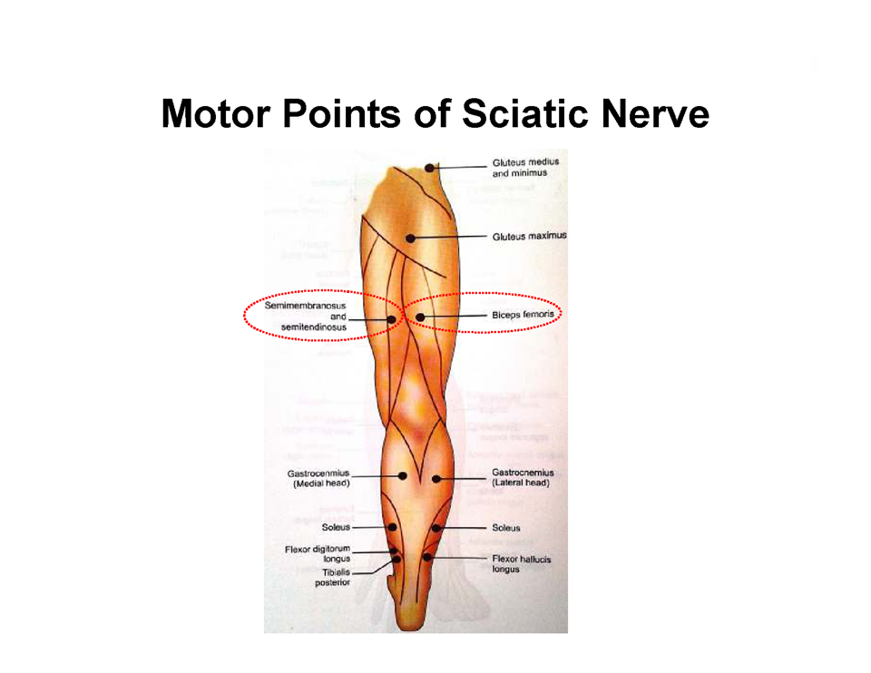

Slide 34
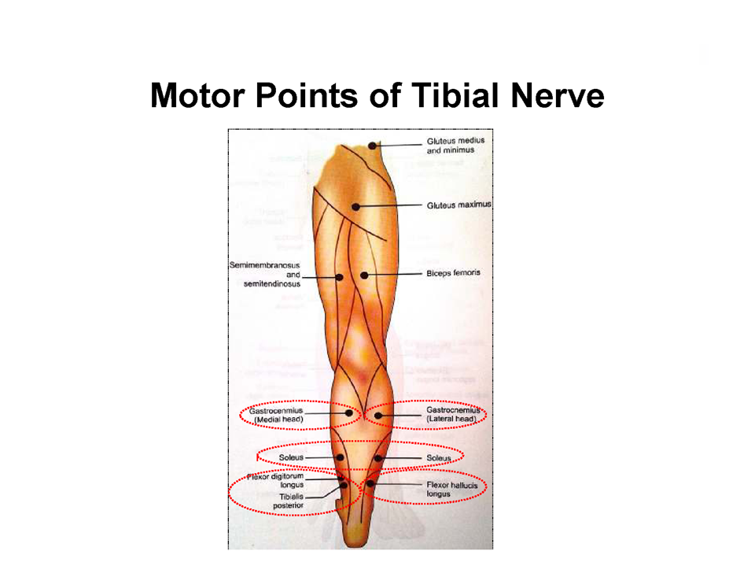

Slide 35
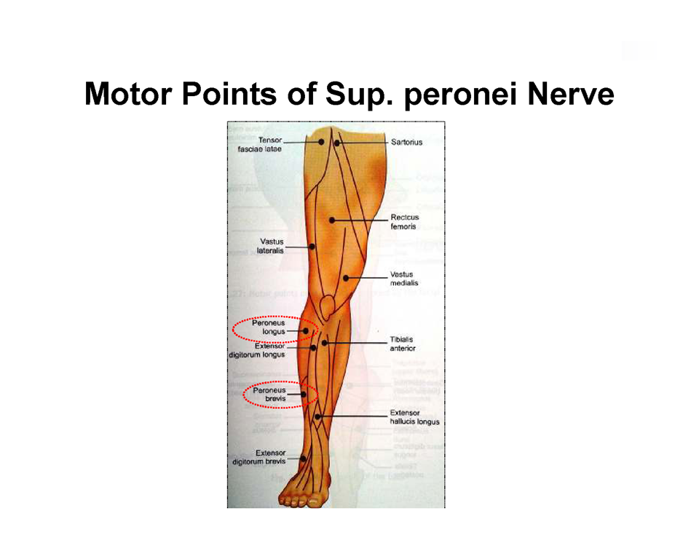

Slide 36
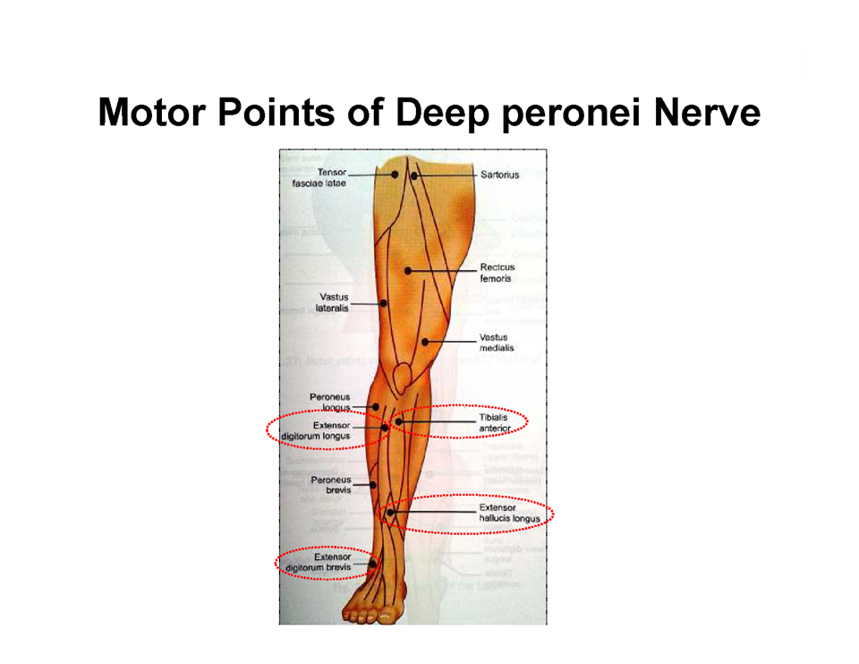

Slide 37
Precaution & Dangers
If the skin sensation is not normal, it is preferable to position the electrodes at an alternative site which ensures effective circulation.
Avoid active epiphyseal regions in children.
Select stimulation parameters appropriate to the effect desired.
Inappropriate stimulation parameters may cause muscle damage, reduction in blood flow through the muscle and low frequency muscle fatigue.
Appropriate care should be taken to ensure that the level of muscle contraction initiated does not compromise the muscle nor the joint(s) over which it acts.
Patients with a history of epilepsy should be treated at the discretion of the physiotherapist in consultation with the appropriate medical practitioner.

Slide 38
Dangers
Burns
Electric shock
Hypovolemic shock

Slide 39

Reference

