Slide 1
Magnetism
Dr Kapil Garg
Dept. Of Musculoskeletal Physiotherapy
MGM Institute Of Physiotherapy
Chh. Sambhajinagar

Slide 2
Magnetism is the force exerted by magnets when they attract or repel each other.
Magnetism is caused by the motion of electric charges.
Every substance is made up of tiny units called atoms. Each atom has electrons, particles that carry electric charges.

Slide 3
Magnetic Field
Magnetic fields, like gravitational fields, cannot be seen or touched. We can feel the pull of the Earth’s gravitational field on ourselves and the objects around us, but we do not experience magnetic fields in such a direct way.
We know of the existence of magnetic fields by their effect on objects such as magnetized pieces of metal, naturally magnetic rocks such as lodestone, or temporary magnets such as copper coils that carry an electrical current.

Slide 4
If we place a magnetized needle on a cork in a bucket of water, it will slowly align itself with the local magnetic field. Turning on the current in a copper wire can make a nearby compass needle jump. Observations like these led to the development of the concept of magnetic fields.

Slide 5
Properties of Magnets
Magnets are common to everyone.
They stick to our refrigerator, are used to give high resolution images in medicine (MRI) and are an essential ingredient of light.
Magnets can be made and can be found in their natural form.
Natural magnets are from the stone magnetite (loadstone)
Magnetism is a force of attraction or repulsion due to an arrangement of electrons.
All magnets have magnetic poles.

Slide 6
Magnetic materials:
Natural magnets are made of magnetite
Most of the magnets that you use have been magnetized
The process of making magnets is called magnetic induction.
Temporary magnets are made of soft iron and are easy to magnetize.
Cobalt, Nickel and hard Iron are used in the production of good strong magnets

Slide 7
Types of Magnet
Permanent magnet
Temporary magnet
Electromagnet.

Slide 8
Types of Magnetism
A physical phenomenon caused by magnetic fields. A force that might also attract or repel items that have magnetic properties, such as iron, is known as magnetism.

Slide 9
1. Diamagnetism - A magnetism characterized by materials that correspond at right angles toward a non-uniform distribution magnetic field and partially expel the magnetic field in which they have been positioned from their interiors. A diamagnetic substance is one whose atoms have no permanent magnetic dipole moment.

Slide 10
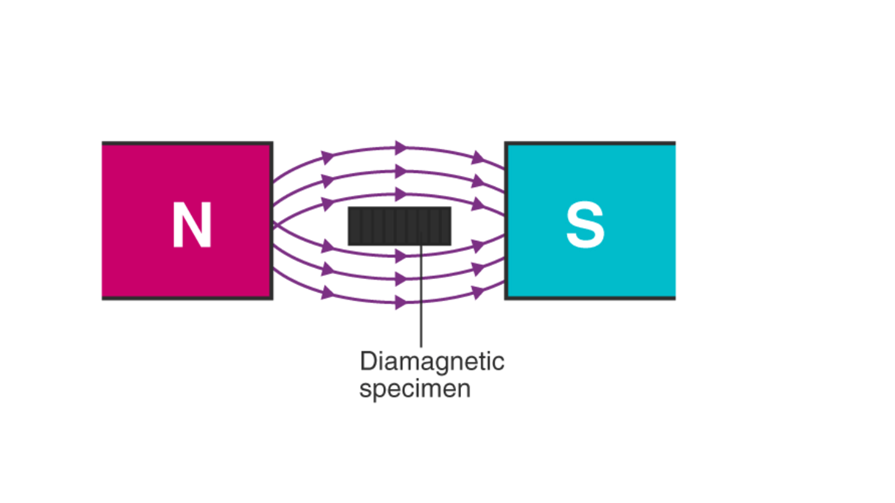

Slide 11
Consider the figure shown above. We have a diamagnetic substance placed in an external magnetic field. We see that the field lines get repelled by the material and the field inside the material is reduced. If we place this substance in a non-uniform magnetic field, it tends to move from the point of a high electric field to that of a low electric field.

Slide 12
2. Paramagnetism - Paramagnetism is the magnetic state of an atom with one or even more unpaired electrons. In a paramagnet, magnetic moments tend to be randomly orientated due to thermal fluctuations when no magnetic field exists.
In an applied magnetic field these moments start to align parallel to the field such that the magnetization of the material is proportional to the applied field. This can be illustrated in the diagram below.

Slide 13
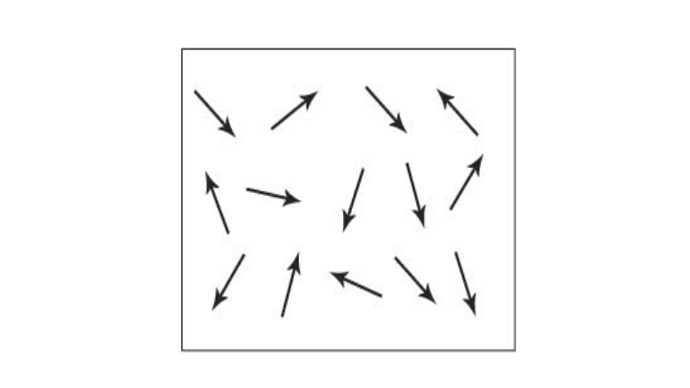

Slide 14
3. Ferromagnetism - Ferromagnetism is a physical phenomenon whereby some materials, such as iron, attract one other aggressively. The magnetic moments in a ferromagnet have the tendency to become aligned parallel to each other under the influence of a magnetic field.
However, unlike the moments in a paramagnet, these moments will then remain parallel when a magnetic field is not applied. This can be illustrated in the diagram below.

Slide 15
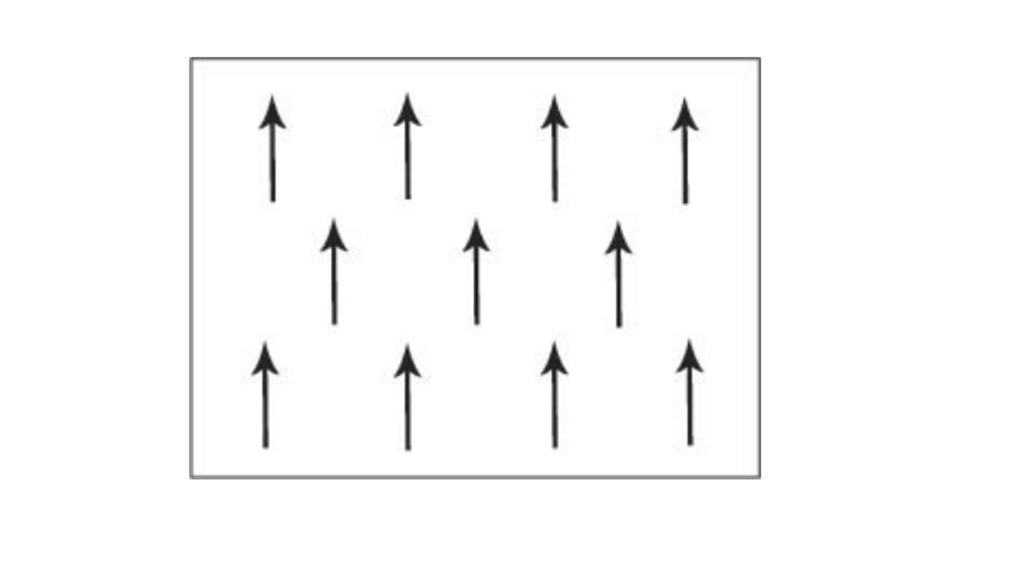

Slide 16
4. Anti-ferromagnetism - Anti-ferromagnetism is a kind of magnetism wherein the magnetic moments of adjacent atoms are antiparallel. Adjacent magnetic moments from the magnetic ions tend to align anti-parallel to each other without an applied field. In the simplest case, adjacent magnetic moments are equal in magnitude and opposite therefore there is no overall magnetization. This can be illustrated in the diagram below.

Slide 17
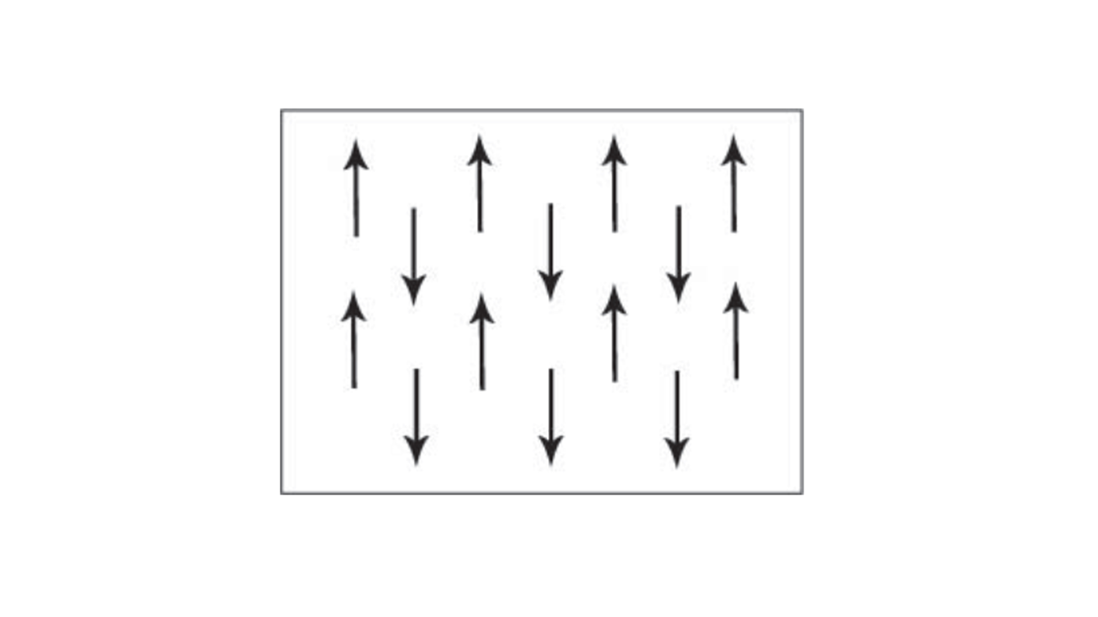

Slide 18
5. Ferrimagnetism - Magnetism in which magnetic moments possess oppositional moments, akin to anti-ferromagnetism is called ferrimagnetism. The aligned magnetic moments are not of the same size; there is more than one type of magnetic ion. An overall magnetization is produced but not all the magnetic moments may give a positive contribution to the overall magnetization. This can be illustrated in the diagram below.

Slide 19
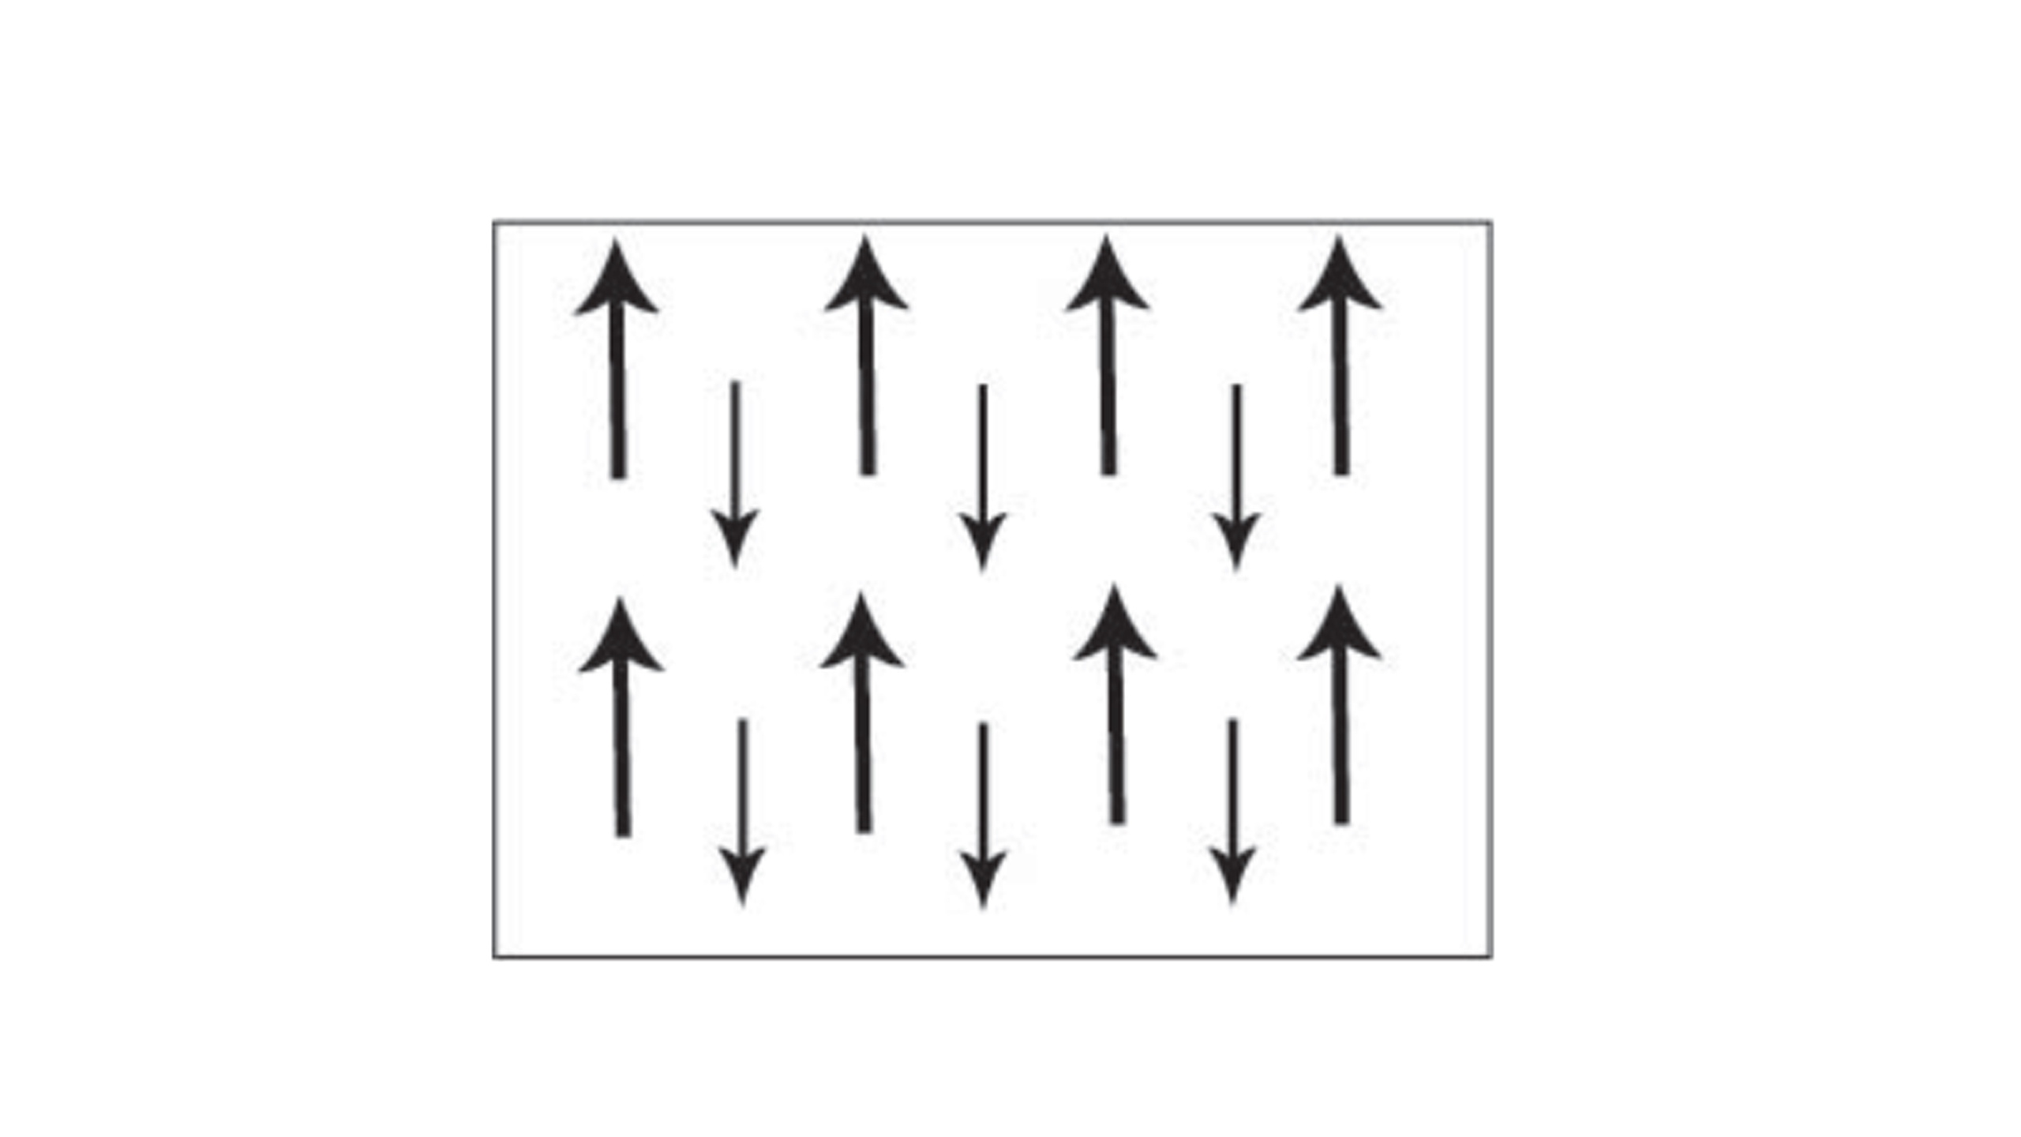

Slide 20
THANK YOU

