Slide 1




STRETCHING
Dr. Mrugnayani
Dept of Sports Physiotherapy
MGM Institute Of Physiotherapy
Chh. Sambhajinagar

Slide 2

DEFINITION
Stretching is a general term used to describe any therapeutic maneuver designed to increase the extensibility of soft tissues, thereby , improving flexibility by elongating(lengthening) structures that have adaptively shortened and have become hypomobile over time
Systematic examination, evaluation, and diagnosis

Slide 3
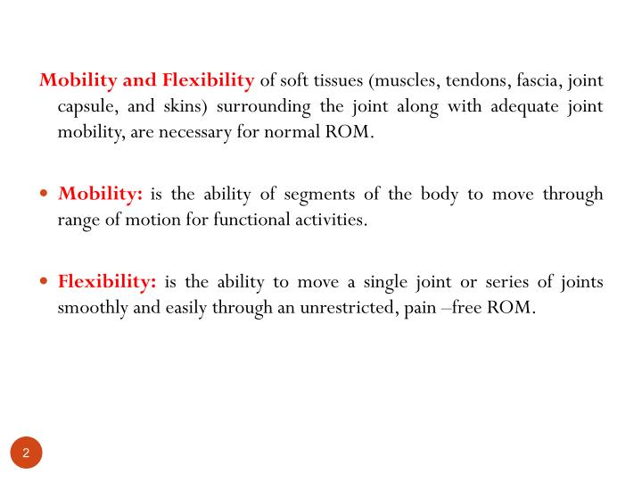

Slide 4
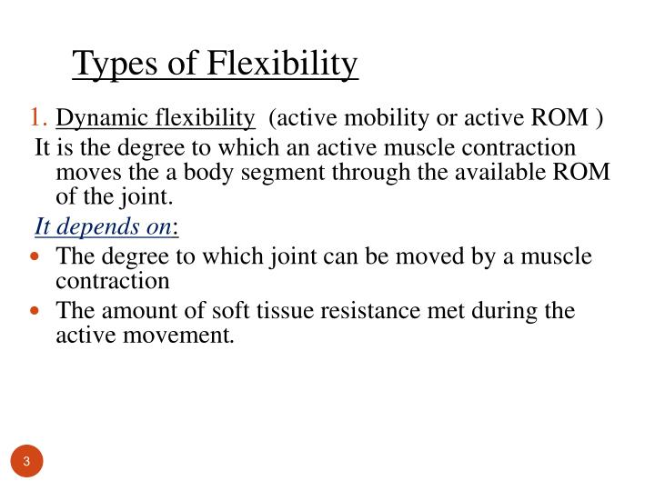

Slide 5
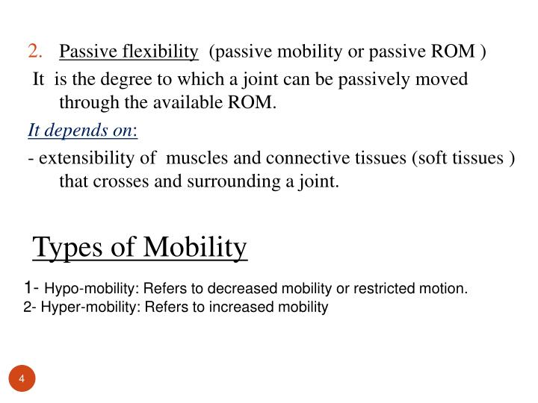

Slide 6
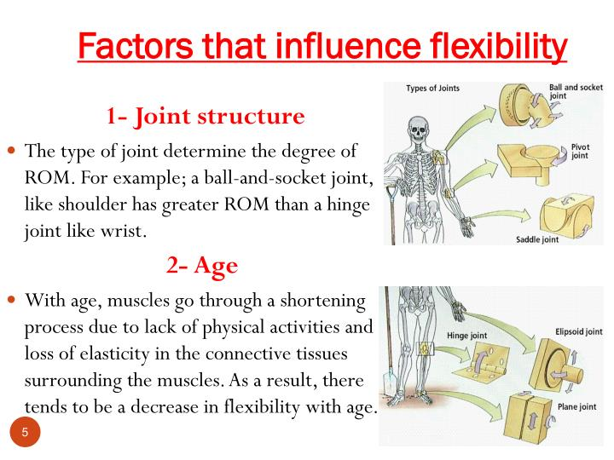

Slide 7
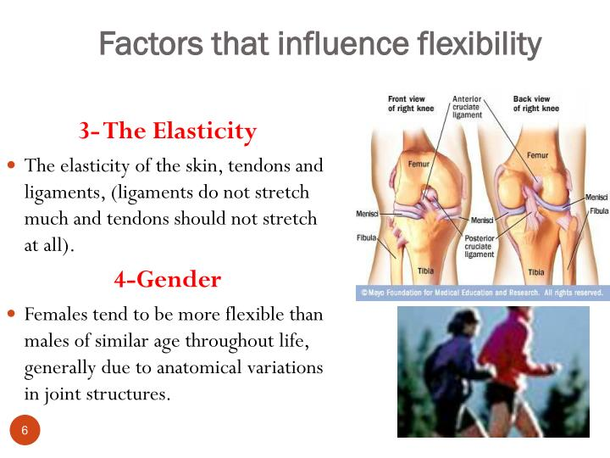

Slide 8
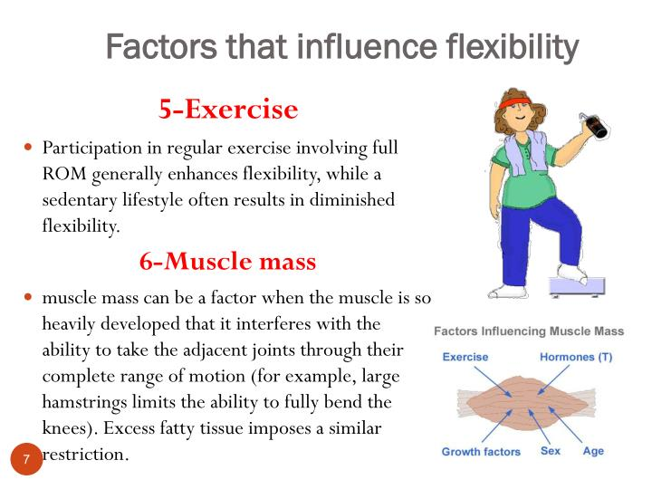

Slide 9
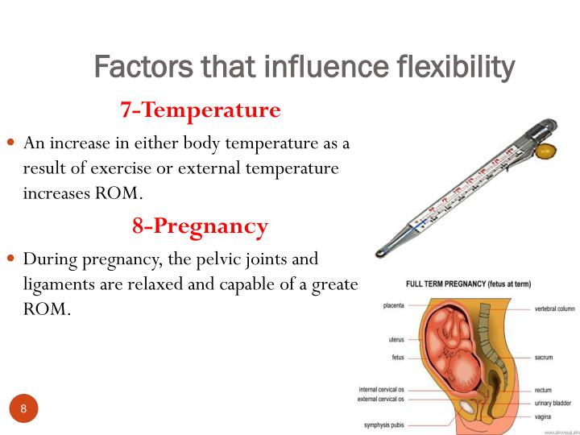

Slide 10
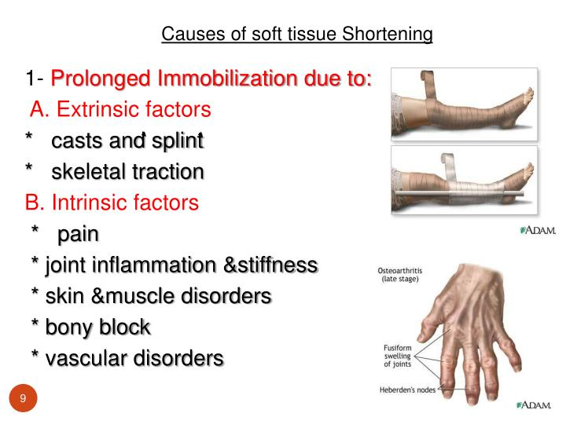

Slide 11
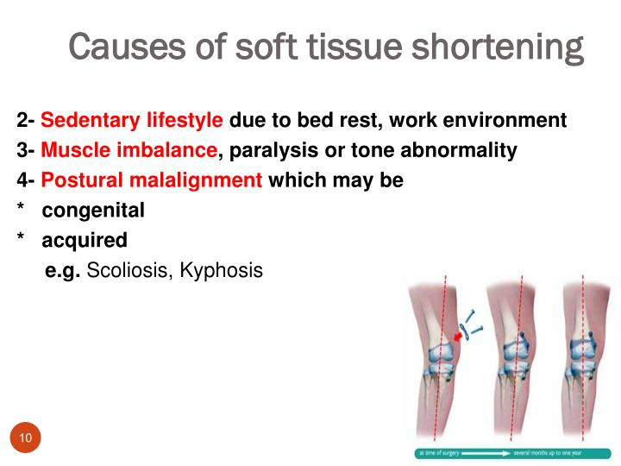

Slide 12
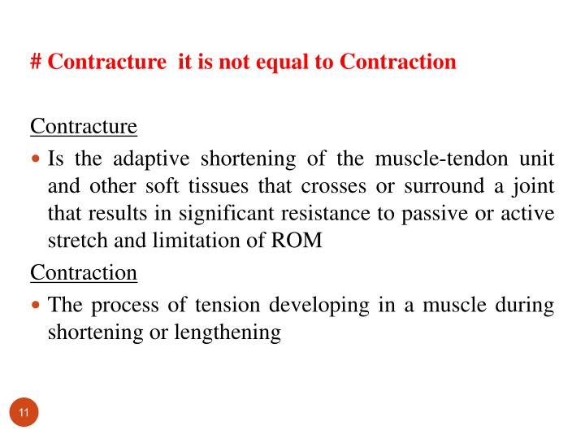

Slide 13
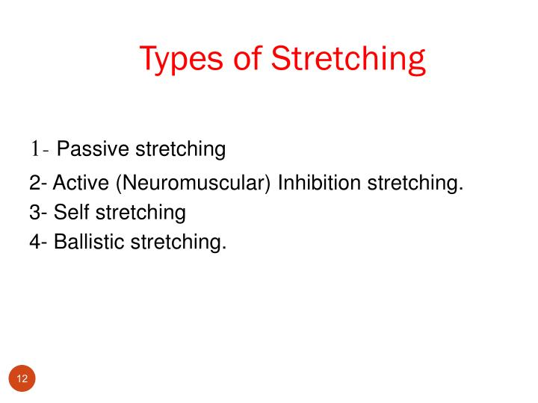

Slide 14
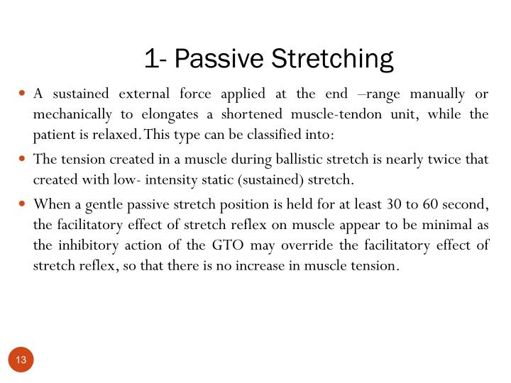

Slide 15
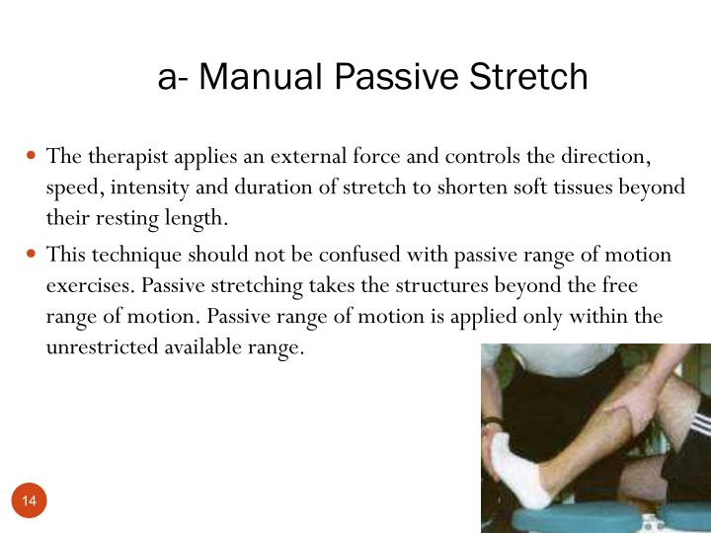

Slide 16
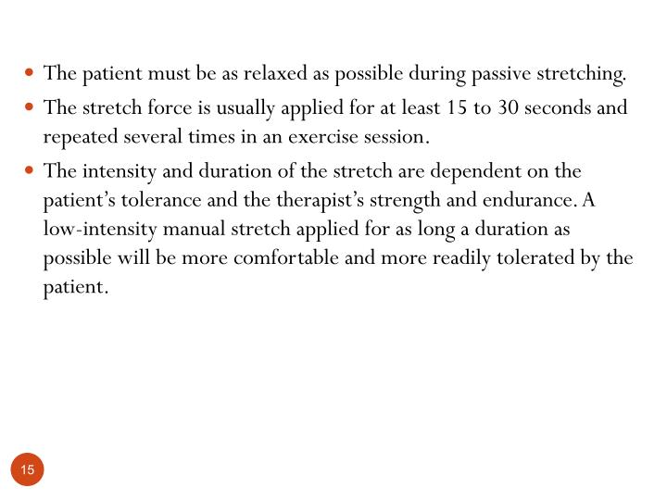

Slide 17
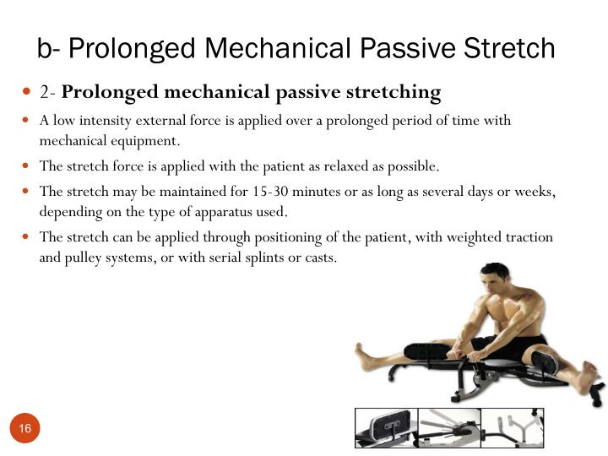

Slide 18
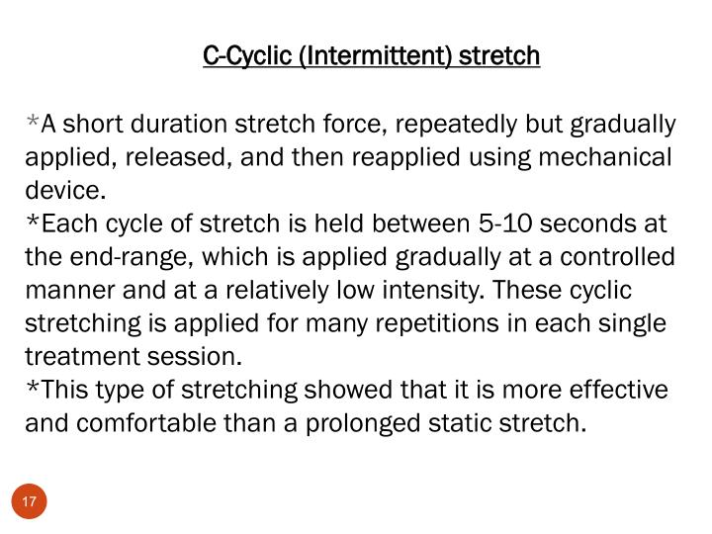

Slide 19
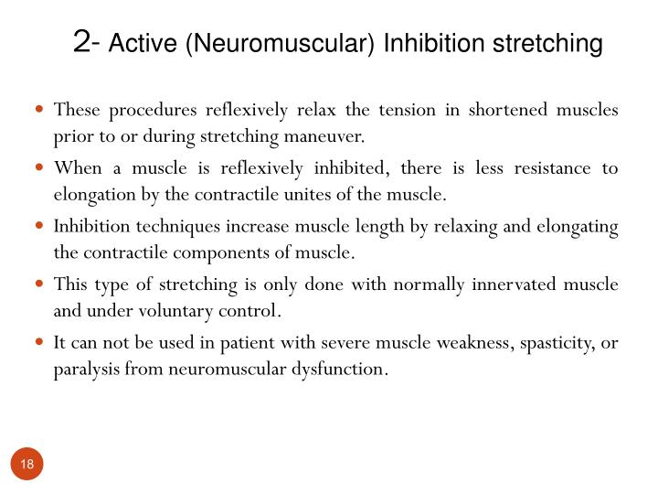

Slide 20
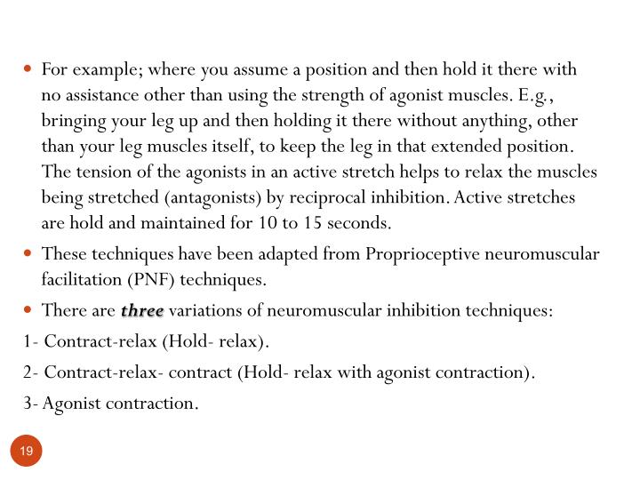

Slide 21
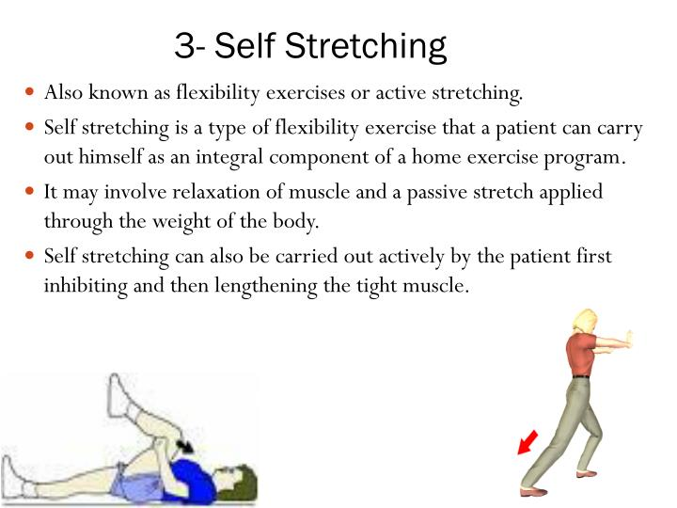

Slide 22
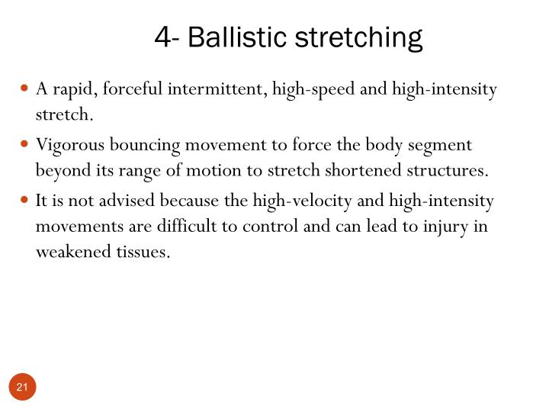

Slide 23
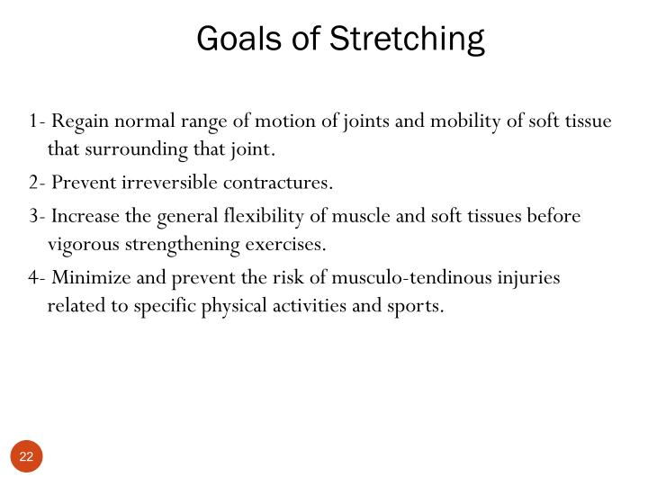

Slide 24
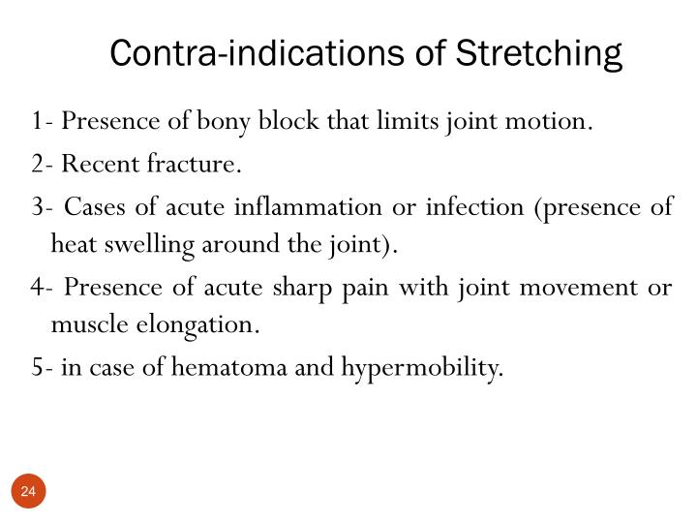

Slide 25
Alignment
Stabilization
Intensity of stretch
Duration of stretch
Speed of stretch
Frequency of stretch
Mode of stretch

Slide 26

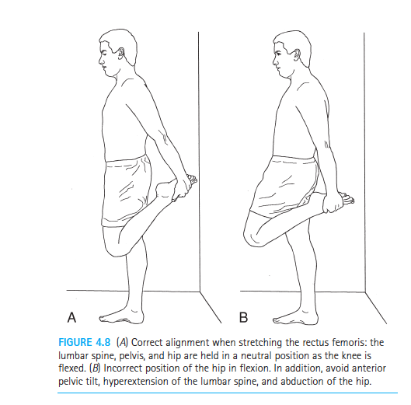

ALIGNMENT
Proper alignment or positioning of the patient and the specific muscles and joints to be stretched is necessary for patient comfort and stability during stretching.

Slide 27
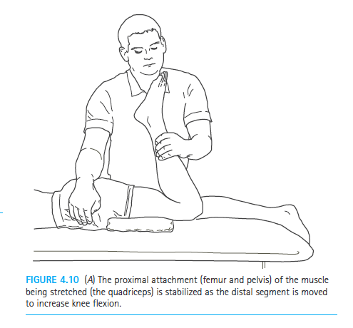
STABILIZATION
To achieve an effective stretch of a specific muscle or muscle group and associated periarticular structures, it is imperative to stabilize (fixate) either the proximal or distal attachment site of the muscle-tendon unit being elongated.
Either site may be stabilized, but for manual stretching it is common for a therapist to stabilize the proximal attachment and move the distal segment

Slide 28
INTENSITY OF STRETCH
The intensity (magnitude) of a stretch force is determined by the load placed on soft tissue to elongate it.
There is general agreement among clinicians and researchers that stretching should be applied at a low intensity by means of a low load

Slide 29
DURATION OF STRETCH
The duration of stretch refers to the period of time a stretch force is applied, and shortened tissues are held in a lengthened position. Duration most often refers to how long a single cycle of stretch is applied.
If more than one repetition of stretch (stretch cycle) is carried out during a treatment session (which is most often the case), the cumulative time of all the stretch cycles is also considered an aspect of duration.

Slide 30
SPEED OF STRETCH
To ensure optimal muscle relaxation and prevent injury to tissues, the speed of stretch should be slow
The stretch force should be applied and released gradually.
Ballistic Stretching
High-Velocity Stretching in Conditioning Programs and Advanced-Phase Rehabilitation

Slide 31
FREQUENCY OF STRETCH
Frequency of stretching refers to the number of bouts (sessions) per day or per week a patient carries out a stretching regimen.
The recommended frequency of stretching is often based on the underlying cause of impaired mobility, the quality and level of healing of tissues, the chronicity and severity of a contracture, as well as a patient’s age, use of corticosteroids, and previous response to stretching

Slide 32
A therapist must be aware of any breakdown of tissues with repetitive stretch.
A fine balance between collagen tissue breakdown and repair is needed to allow an increase in soft tissue lengthening

Slide 33
Mode of Stretch
The mode of stretch refers to the form of stretch or the manner in which stretching exercises are carried out.
Mode of stretch can be defined by who or what is applying the stretch force or whether the patient is actively participating in the stretching maneuver.

