Slide 1
GBS
Dr. Nawaj Pathan
Dept of Neurophysiotherapy
MGM Institute of Physiotherapy
Chh. Sambhajinagar

Slide 2
Introduction
GBS or Acute inflammatory demylinating, immune-mediated polyneuropathy, is the most common form of the disease.
GBS affects nerve roots and peripheral nerves, leading to motor neuropathy and flaccid paralysis with possible sensory and ANS effects.
Purely motor forms and mixed motor and sensory forms of GBS are also found commonly.
Usually has a good prognosis, with most patients returning to their prior functional status by 1 year after onset.
The incidence of GBS is approximately one to four cases per 100,000 persons

Slide 3
Etiology
It affects both genders at any age; mainly 20-50.
It is consider to be due to hypersensitivity or allergy to unknown viruses or allergens.
Approximately 27% of patients with GBS have no identified preceding illness.
However it is noted that, more than two thirds had symptoms of an infectious disease 2 weeks before the onset of GBS symptoms.
Evidence exists to support connections with Campylobacter jejuni, Mycoplasma pneumoniae, cytomegalovirus, and Epstein-Barr virus.
In GBS the spinal roots and peripheral nerves are infiltrated with macrophages and T lymphocytes.

Slide 4
The syndrome presents with as a symmetrical weakness of muscles, hypotonia & partial or complete loss of Deep Tendon Reflexes.
The motor symptoms starts usually from distally and move proximally.
The disease may also affects trunk muscle and cranial muscles.
Pain is usually associated with tenderness.
Paraesthesia is often present in the limbs.
Both sensory and motor nerve conduction velocities are reduced.
Autonomic functions may sometimes affected usually cardiac muscle, leads to sinus arrhythmias and fluctuations in blood pressure ranges.
The symptoms may progress for one to several weeks until disease peaks and pleatues out.

Slide 5
Pathology
Process affects the spinal roots and nerve process.
Primarily targets the schwann cells results in segmental demylination of nerve process initially.
Later it will turn out as proliferation in the schwann cells.
The axon remains intact throughout the demylination & can conduct the an impulse with much reduced velocity.
Later in late stages of the disease axonal degeneration may also occur leading to complete conduction block.

Slide 6
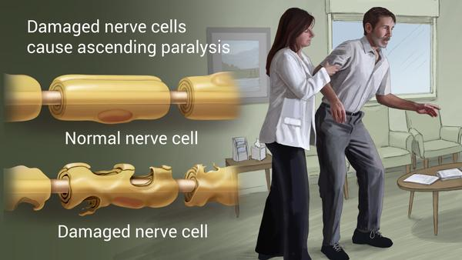
Pathological Process of GBS
Image download from Google for illustration Purpose only.

Slide 7
Variants of Guillain-Barre´ syndrome
Regional
Fisher syndrome of ophthalmoplegia, ataxia, and areflexia
Cervico-brachial-pharyngeal, often with ptosis
Oculopharyngeal weakness
Predominant paraparesis
Bilateral facial or abducens weakness with distal paresthesias
Ophthalmoplegia with GQ1b autoantibodies
Functional
Generalized ataxia without dysarthria or nystagmus
Pure sensory
Pure motor
Pandysautonomia
Axonal
Symptomatology The typical case of GBS is readily identified.

Slide 8
Prognosis
Relatively good to moderate
Takes around 6 months to 1 year for complete recovery

Slide 9
Complications
In severe cases who need respiratory assistance, infections of the lower respiratory tract can be hazards
Deep vein thrombosis
Urine retentions is an uncommon complications

