Slide 1
Biofeedback
Dr. Preeti Ganachari
Dept. Of Neurophysiotherapy
Mgm Institute Of Physiotherapy
Chh. Sambhajinagar

Slide 2
Contents
Introduction
Definition
Instrumentation
General principles
Biofeedback and Rehabilitation

Slide 3
Biofeedback is an instrumentation and technique which is used to accurately measure, process and feedback some reinforcing information via auditory or visual signals by electronic or electromechanical device especially for therapeutic purposes.
Biofeedback- assesses physiological function- improves it by gaining control

Slide 4
Information is recorded and displayed in front of the patient.
Various information can be reinforced back to the patient like kinaesthetic, visual, auditory, cutaneous, vestibular etc.
Patient visualises function.
Target is set either higher or lower than normal capacity of the patient.
The aim is to achieve this target.

Slide 5
definition
“The process of furnishing an individual information of his body function, so as to get some control over it.”

Slide 6
Biofeedback instrumentation
Designed to monitor some physiologic event, objectively quantify these monitoring and then interpret the measurements as meaningful information.

Slide 7
Peripheral Skin Temperature:
Indirect measure- diameter of peripheral blood vessels
Finger photo transmission:
Indirect measure- peripheral vasoconstriction- photo plethysmograph
Light sensors detect the volume change in blood, i.e.
Decrease in volume- increased light sensor activity- vasoconstriction
Increase in blood volume- decreased light sensor activity- vasodilatation
Eg. Pulseoximeter

Slide 8
Skin Conductance Activity:
Instrument applies small electrical voltage to the skin (palmar/volar) to measure the skin conductance
Sweat gland activity- Determined by electro dermal activity or Galvanic Skin Response (GSR)
Salt increases electrical conductivity
Lie detector testing
EMG, EEG, Pressure transducers and electrogoniometers

Slide 9
General principles
Providing feedback:
- Feedback should be appropriate for the change required
- Feedback should be easily recognised and used by the patient
Feedback- Proportional to the response
- Strong feedback- Stronger response
- Visual signals >> Auditory feedback,
since its easier to make direct comparisons within and between trials

Slide 10
Biofeedback- Sensitive and specific
Time
Signal- Feedback- Response

Slide 11
Successful biofeedback:
Externally provided signal and outcome are associated
Feedback is accessible
Willingness to practice
Desire to control the process

Slide 12
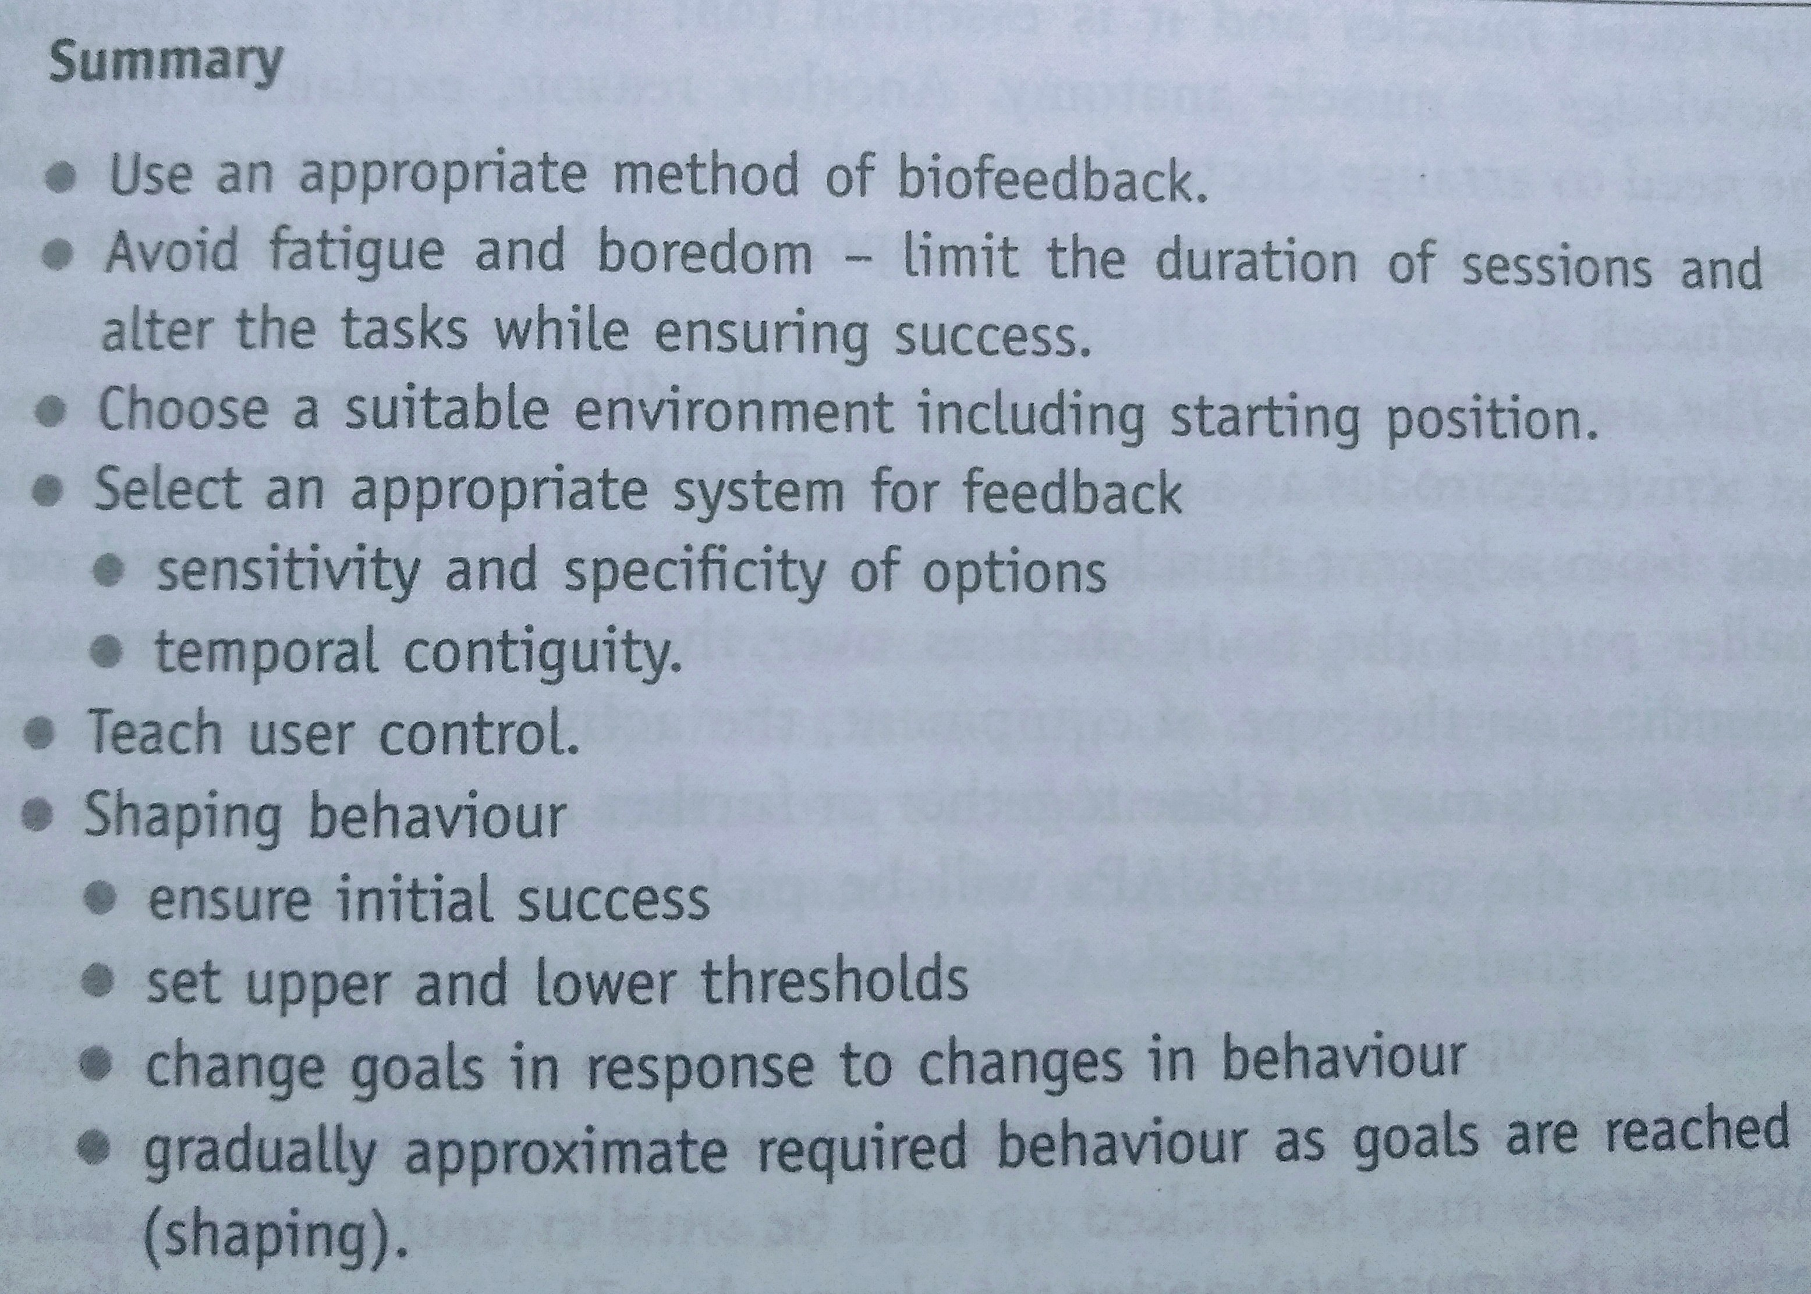

Slide 13
Biofeedback & rehabilitation
Enhancer of therapy- adjunct
Reliance on self (performance) >>> Reliance on therapist*

Slide 14
limitations
Relevancy: relevant stimuli important for desired motor response
Neither too short nor too long
Accuracy: The device should provide accurate information- appropriate device, apt technique of application
Rapid information: Reduce the lag

Slide 15
uses
PNI
SCI
Hemiplegia
Dystonic conditions
CVA
Postural Control
Muscle strengthening
Functional reeducation
Providing relaxation

