Slide 1
pain
Dr. Preeti Ganachari
Dept. Of Neurophysiotherapy
Mgm Institute Of Physiotherapy
Chh. Sambhajinagar

Slide 2
Contents
Introduction
Definition
Pain pathways
Pain gate theory
Descending pain suppressing system
Physiological block

Slide 3
introduction
Pain is a complex and multifaceted response to noxious stimuli or to potential or actual tissue damage
Part of complexity is due to the range of possible modifications to that might be perceived as pain from the different body parts
These modifications may occur during or after a painful event or series of events

Slide 4
Complexity of pain:
The response to Injury is variable between individuals and over time
Apparently innocuous stimuli can cause pain
The location of pain is not necessarily that of any physical damage
The nature and location of pain may change with time

Slide 5
Definition
An unpleasant sensory & emotional experience associated with actual or potential tissue damage, or described in terms of such damage- Merskey 1990
(The International Association for the Study of Pain)

Slide 6
The Nervous System and pain
Nervous system
Brain
PNS
Spinal cord
Thalamus
Somatosensory cortex
Afferent and Efferent Neurons
Dorsal root ganglion

Slide 7
PNS Nerve fibre types
Afferent-Sensory Neurons
A-beta fibres – large diameter, fast transmitting, myelinated sensory fibres
A-delta fibres – smaller, fast transmitting, myelinated fibres that transmit sharp pain
Mechanoreceptors, thermal
C-fibres – smallest, slow transmitting unmyelinated nerve fibres that transmit dull or aching pain.
Mechanoreceptors & Chemoreceptors
Efferent – Motor neurons
Interneurons – Connect Afferent and Efferent

Slide 8
Spinal cord
Multiple ascending and descending tracts of neurons
Afferent Neurons – Enters from the dorsal side
Substantia Gelatinosa
Composed of two layers of cell bodies running up and down the dorsal horns of the spinal cord
Receive input from A and C-fibers
Activity in SG inhibits pain transmission
Efferent Neurons – Exit the ventral (front) side

Slide 9
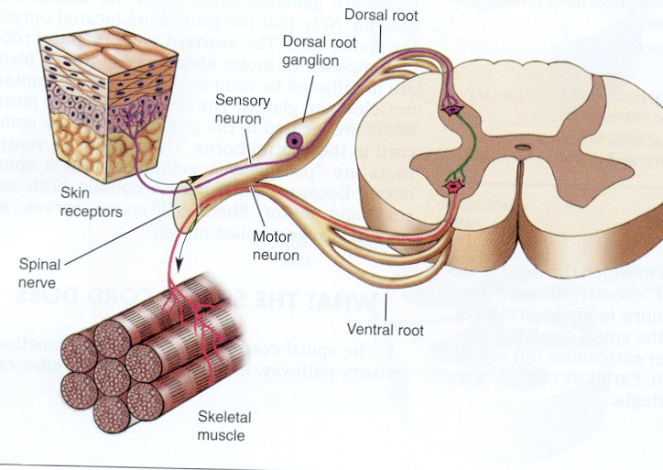

Slide 10
Pathways of pain sensation
1ST ORDER NEURONS:
These are the cells in the post. Nerve root ganglia.
These neurons receive impulses of pain sensation from the pain receptors through their dendrites & their axons carry the pain impulses to the spinal cord.
Aδ fibers synapse with marginal cells & C type with substantia gelatinosa in the post. Gray horn.

Slide 11
2ND ORDER NEURONS:
The marginal cells & the cells of substantia gelatinosa form the 2nd order neurons.
Fibers from these cells ascend in the form of the lateral spinothalamic tract.

Slide 12
3RD ORDER NEURONS:
The 3rd order neurons of pain pathway are the neurons of thalamic nu, reticular formation, tectum & gray matter around aqueduct of sylvius.
Axons from these neurons reach the sensory area of cerebral cortex.
Some fibers from reticular formation reach hypothalamus.

Slide 13
CENTER FOR PAIN SENSATION:
Located in post central gyrus of parietal cortex.
Fibers reaching hypothalamus are concerned with arousal mechanism due to pain stimulus.

Slide 14
Spinal neuron that sub serve pain
Wide Dynamic Range Neurons (WDR):
WDR neurons exist in high concentration in laminae V & VI of the dorsal horn & to a lesser extent I, II & IV.
Many WDR neurons in laminae I & V are spinothalamic tract neurons.
WDR are source of low-threshold Cutaneous Mechanoreceptive input.
WDR respond to gentle touch, firm pressure & pinch.

Slide 15
NOCICEPTIVE SPECIFIC NEURONS (NS):
These neurons respond exclusively to nociceptive stimuli.
NS exist in high concentrations in the superficial layers of the dorsal horn
Existence of NS neurons supports specificity theory of pain.
Major sources of input to theses neurons are high threshold Aδ mechanosensitive afferents, Aδ heat nociceptive afferents, & C polymodal nociceptive afferents.

Slide 16
SPINAL CORD TRANSMISSION PATHWAYS
Spinothalamic tract
Spinoreticular tract
Spinomesencephalic tract
Dorsal column-medial lemniscal system

Slide 17
Anterior spinothalamic tract
Aβ fibres carry sensory information pertaining to crude touch from the skin.
After entering the spinal cord the first order neurons synapse (in the nucleus proprius), and the second order neurons decussate via the anterior white commissure.
These second order neurons ascend synapsing in the Ventral Postero Lateral nucleus of the thalamus.
Function: pressure and crude touch

Slide 18
Lateral spinothalamic tract
Composed primarily of fast-conducting, sparsely myelinated A delta fibers and slow-conducting, unmyelinated C fibres.
These are secondary sensory neurons which have already synapsed with the primary sensory neurons of the peripheral nervous system in the posterior horn of the spinal cord.
Carries pain, crude touch and temperature sensory information.

Slide 19
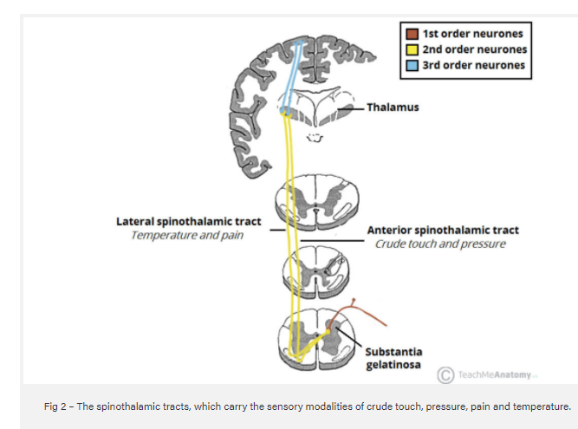

Slide 20
The types of sensory information means that the sensation is accompanied by a compulsion to act. For instance, an itch is accompanied by a need to scratch, and a painful stimulus makes us want to withdraw from the pain.

Slide 21
There are two sub-systems identified:
Direct (for direct conscious appreciation of pain)
Indirect (for affective and arousal impact of pain). Indirect projections include
  Spino-Reticulo-Thalamo-Cortical (part of the ascending reticular arousal system, aka ARAS)
  Spino-Mesencephalic-Limbic (for affective impact of pain).

Slide 22
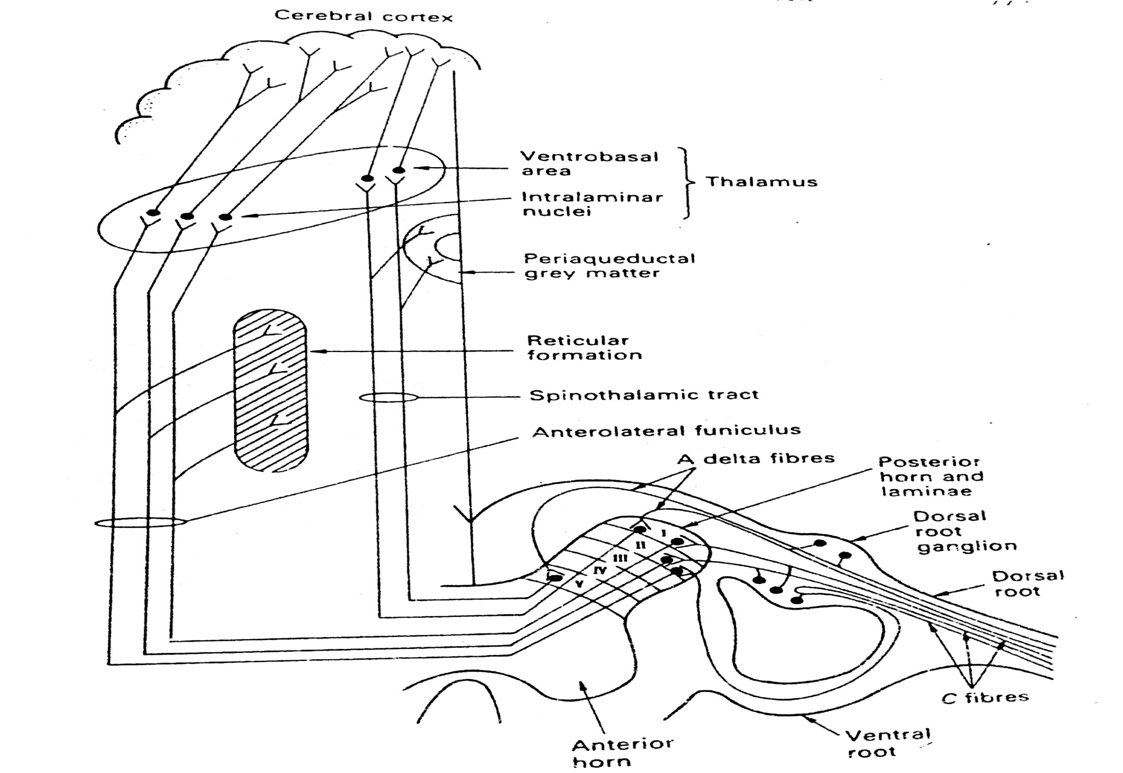

Slide 24
cns
The portions of the central nervous system involved in interpreting pain signals include the limbic system, reticular formation, thalamus, hypothalamus, medulla and cortex .

Slide 25
The Medulla
Medulla is also involved in the motivational/affective aspects of pain.
Important cell groups are the:
nucleus gigantocellularis and related nuclei,
the lateral reticular nucleus,
and a variety of other nuclei.

Slide 26
midbrain
There is a host of pain-related structures in the midbrain. Most of this circuitry is involved in 'affective' pain, with extensive connections to the reticular system of the brainstem. Important components are:
The peri-aqueductal grey matter (PAG)
Deep layers of the superior colliculus

Slide 27
Pain gate theory
The gate control theory of pain was proposed by Melzack and Wall in 1965 to describe a process of inhibitory pain modulation at the spinal cord level. It helps to explain why when we bang our head, it feels better when we rub it.
By activating Aβ fibres with tactile, non-noxious stimuli inhibitory inter neurons in the dorsal horn are activated leading to inhibition of pain signals transmitted via C fibres

Slide 28
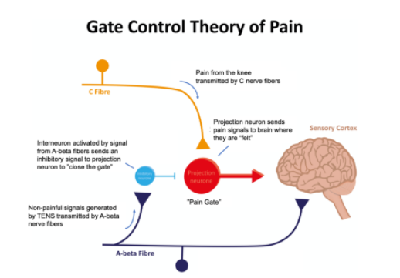

Slide 29
Melzack & Wall, 1965
Substantia Gelatinosa (SG) in dorsal horn of spinal cord acts as a ‘gate’ – only allows one type of impulses to connect with the Second Order Neuron
Transmission Cell (T-cell) – distal end of the Second order neuron
If A-beta neurons are stimulated – SG is activated which closes the gate to A-delta & C neurons
If A-delta & C neurons are stimulated – SG is blocked which closes the gate to A-beta neurons

Slide 30
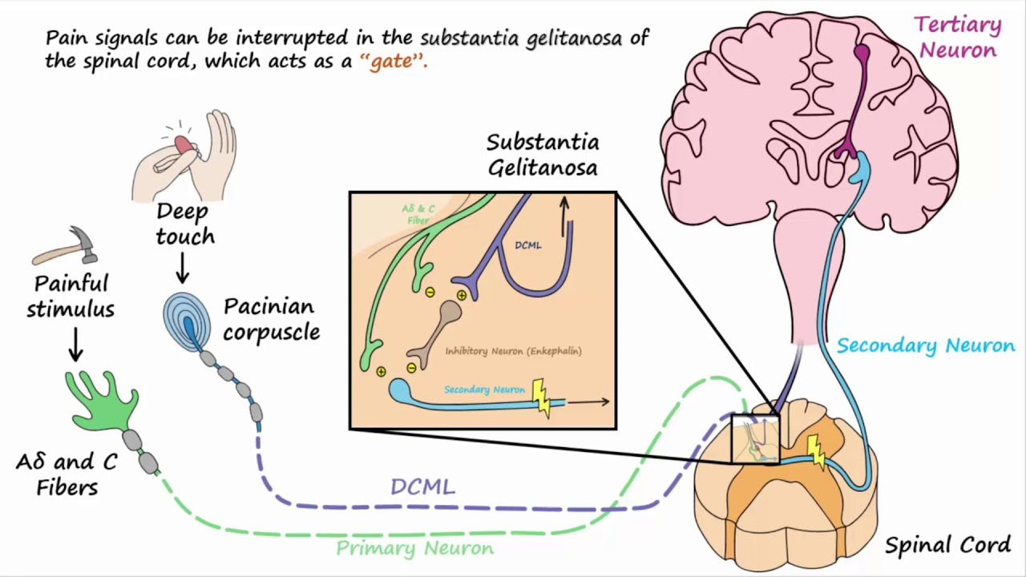

Slide 31
According to this severity of the pain is determined by the balance of excitatory and inhibitory inputs to the T cells in the spinal cord.
T cells receives input from C and A-delta nociceptor afferents and inhibitory input from large diameter A-beta non nociceptors sensory afferents (via the substantia gelatinosa).

Slide 32
Large fibres reduces nociceptive traffic,
Smaller fibres increases nociceptive traffic
If large diameter blocks the gate, the release of substance P is inhibited & pain sensation suppressed.

Slide 33
Gate - located in the dorsal horn of the spinal cord
Smaller, slower n. carry pain impulses
Larger, faster n. fibres carry other sensations
Impulses from faster fibres arriving at gate 1st inhibit pain impulses (acupuncture/pressure, cold, heat, chem. skin irritation).

Slide 34
The pain gate effect on both A delta (fast) and C (slow) pain fibres in the posterior horn due to stimulation of mechanoreceptors (A beta) fibres by high-frequency, low intensity electric pulses, sometimes called hi-TENS or traditional TENS.

Slide 35
A morphine-type effect on the C fibre system occurs. This is due to encephalin produced by interneurons in the posterior horn, which have been stimulated by A delta pain receptors fibres. These a Delta fibres are themselves stimulated by low-frequency , high intensity electrical pulses, which are called lo-TENS or acupuncture TENS.

Slide 37
The descending pain modulatory system
The “Top down” modulation of pain was an early work of Sherrington
Fields and Milan elaborated that electrical stimulation of the periaqueductal gray (PAG) area can produce analgesia
Demonstrated through studies that descending influences on spinal nociceptive processing involves the PAG and the rostral ventromedial medulla (RVM).

Slide 38
Hadjipavlou et al stated that the descending pain modulatory system from the brainstem (where the PAG and RVM reside) are linked to a number of higher level brain areas including the amygdalae and the hypothalamus.
This may go someway to help explain the role that emotions and cognition have in processing nociceptive information.

Slide 39
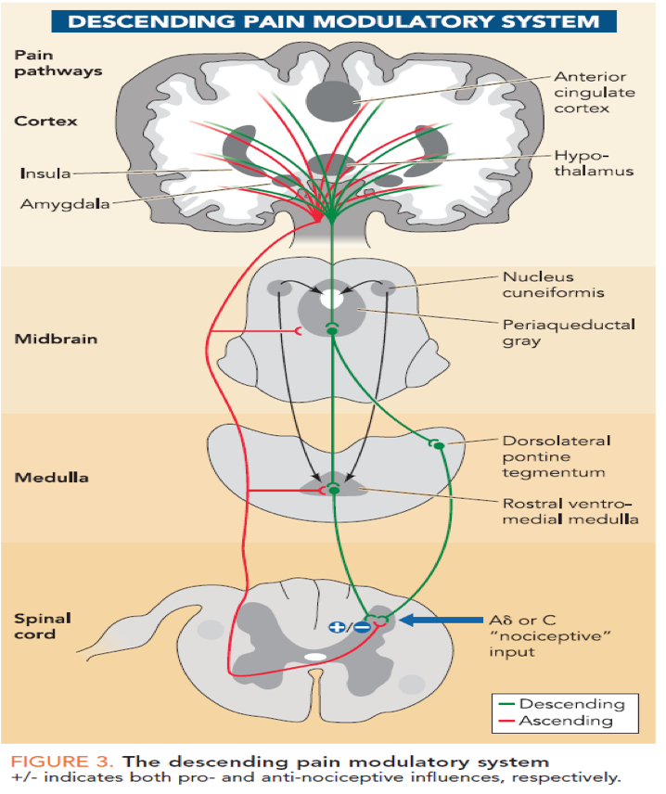

Slide 40
The descending pain modulatory system is the endogenous opoid system and according to Willer this system may be activated by a variety of reflex and cognitively trigged states.
At the spinal cord (dorsal horn) level, the opoid system causes inhibition of substance P from peripheral noxious mechanical stimulation via release of noradrenaline from the dorsolateral PAG (dPAG) and thermal nociceptive stimuli via the release of serotonin from the ventrolateral PAG (vPAG)

Slide 41
Pain signals can be selectively inhibited in the spinal cord through a descending pathway, which originates in the midbrain and ends in the dorsal horn.
That analgesic (pain-relieving) response is controlled by neurochemicals called endorphins, which are opioid peptides such as enkephalins that are produced by the body.
Those substances block the reception of pain stimuli by binding to neural receptors that activate the pain-inhibiting neural pathway.
That system can be activated by stress or shock and is probably responsible for the absence of pain associated with a severe injury. It may also explain the differing abilities among individuals to perceive pain.

Slide 42
Evidence for pain modulatory mechanisms- Beecher (physician) observed severely wounded soldiers reported none to moderate pain and required no medications.
This led to the belief- Strong emotions block pain
Now, generally accepted that the experience of pain does not solely rely on noxious inputs, but many variables interplay with the experience, including memory, mood, environment, attention and expectation

Slide 43
Ultimately, this means the resultant pain experienced to the same sensory input can vary considerably.
It is the brain's job to weigh all the information and decide whether creating pain is the most appropriate response.
This provides a necessary survival function since it allows the pain experience to be altered according to the situation rather than having pain always dominate.

Slide 44
Implications for physiotherapists
This explains why the amount of pain a pt. is experiencing does not necessarily relate to the amount of tissue damage they’ve sustained
Therapist can therefore educate their pts. regarding pain and its suppression activities (Pain neuroscience education)

Slide 45
Manual techniques such as joint mobilisations, manipulations have been proposed to activate the system and significantly contribute to their therapeutic effects.
Noxious stimuli can activate the system and this can help explain why manual techniques that may elicit some pain (to some degree) can be helpful to reduce pain overall.

Slide 46
Summary

