Slide 1
Open suction versus closed suction
Dr. Santosh Dobhal
Dept. Of Cardiovascular & Respiratory Physiotherapy
MGM Institute Of Physiotherapy
Chh. Sambhajinagar

Slide 2
Contents
Definition
General Principles
Complete Suction System
Types Of Suctioning
  Open Suctioning
  Closed Suctioning
Comparison Of Open And Closed Suction
References

Slide 3
introduction
An application of negative pressure (vacuum) to the airways through a collecting tube (flexible catheter or suction tip) is known as airway suctioning.
The purpose of suctioning is to remove retained secretion or other semi-liquid fluids from the airways.
It is an essential procedure for patient requiring prolonged intubation to prevent infections and narrowing of artificial airways.

Slide 4
General principles
Negative Pressure
Flow

Slide 5
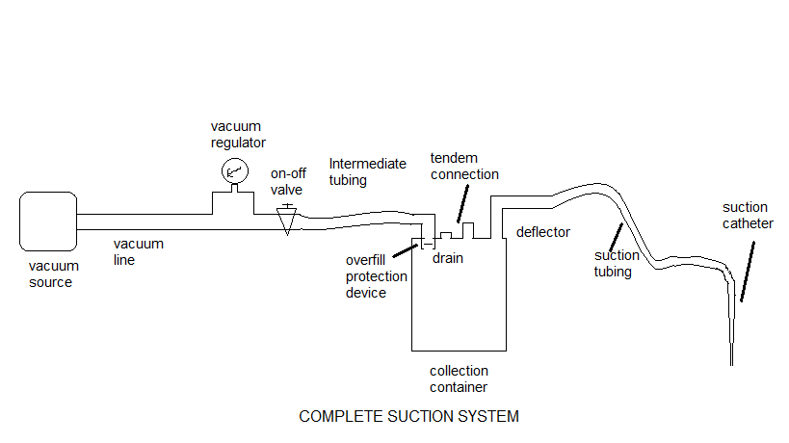
COMPLTE SUCTION SYSTEM
COMPLETE SUCTION SYSTEM

Slide 6
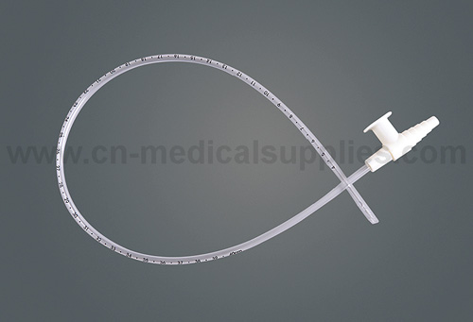
SUCTION CATHETER
Shaft of catheter
Thumb control valve
Connector for vacuum
(machine end)
Side holes or eyes
Tip with suction opening
(patient end)

Slide 7
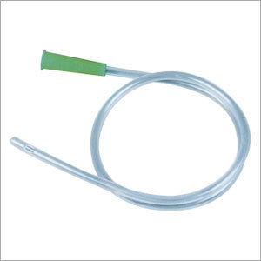
Connector for vacuum
(machine end)
Side holes or eyes
Shaft of catheter
Tip with suction opening
(patient end)

Slide 8
A selection of catheter size is very important, to prevent hypoxemia & atelectasis
To quickly estimate the proper size of suction catheter to use with a given tracheal tube,
E.g. 8-mm endotracheal tube: 2x8=16: next smallest catheter is 14 French

Slide 9
Nominal Outside Diameter (millimetres) | French Size Equivalent | Colour Identification
1.67 | 5 | GRAY
2.0 | 6 | LIGHT GREEN
2.5 | 7.5 | PINK
2.67 | 8 | LIGHT BLUE
3.0 | 9 | TURQUOISE
3.33 | 10 | BLACK
4.0 | 12 | WHITE
4.67 | 14 | GREEN
5.0 | 15 | BROWN
5.33 | 16 | ORANGE
6.0 | 18 | RED
6.67 | 20 | YELLOW
ISO Recognized Suction Catheter Colour Identification & Size

Slide 10
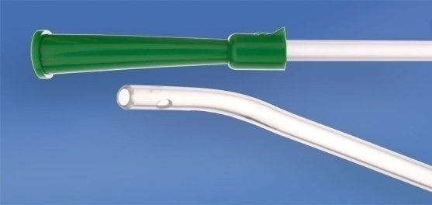
There are number of different suction catheters designed for particular uses.
CURVED TIP catheters facilitate insertion into the desire mainstem bronchus.
J shaped catheter tips are useful for suctioning the right upper lobe bronchus.

Slide 11
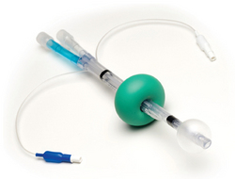
Double lumen catheters with a lumen for oxygen insufflation or for instilling saline are available; it will reduces chances of hypoxemia
A single lumen insufflating suction catheter that allows either insufflations or suction has been described.

Slide 12
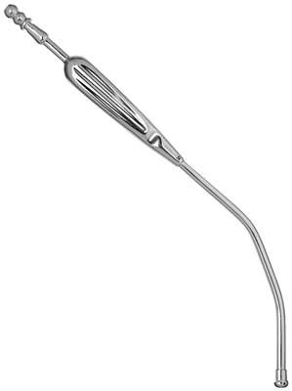
A rigid (Yankauer, tonsil suction) catheter is useful under direct vision, especially in the oral cavity.
It can remove large volumes of fluids more rapidly than a flexible catheter but carries risk of dental damage.
Connector for vacuum
Handle
Thumb control valve
Catheter
Tip

Slide 13
EQUIPMENT NEEDED FOR SUCTIONING
Adjustable suction source/collection system
Sterile suction catheter with thumb port
Sterile gloves
Goggles, Mask, and Gown
Sterile basin
Sterile bulk water or saline
Sterile saline for instillation
Oxygen delivery system
AMBU bag

Slide 14
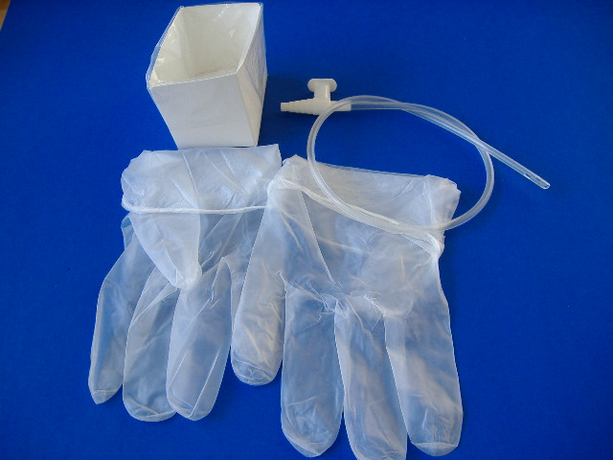
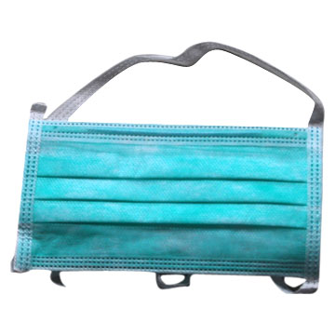

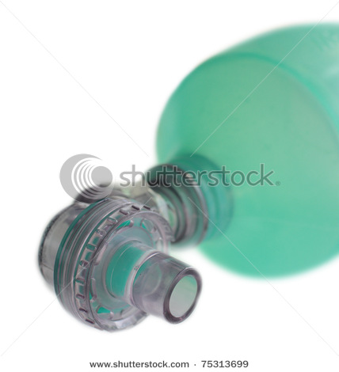

Slide 15
Suction pressure
Set suction pressure as low as possible, yet high enough to effectively clear secretions.
  Infants: (-60 to -80 mmHg)
  Children: (-80 to -100 mmHg)
  Adults: (-100 to -120 mmHg)

Slide 16
SUCTIONING TECHNIQUES
OPEN SUCTION
Endo-tracheal suctioning
Oropharyngeal & Nasopharyngeal suctioning
CLOSED SUCTION
Endo-tracheal suctionig
Tracheostomy suctioning
Naso-tracheal suctioning

Slide 17
According to suction depth
  Deep Suctioning
    Insertion of suction catheter until resistance is met followed by withdrawal of catheter by 1cm before application of negative pressure.
  Shallow Suctioning
    Insertion of suction catheter to predetermine depth, usually the length of the artificial airway plus adapter.

Slide 18
OPEN SUCTIONING
Classically airway suctioning is performed disconnecting the patient from the ventilator and introduced a suction catheter into artificial airways, this technique known as an open suctioning.

Slide 19
Endo-Tracheal Suctioning (ETS)
Most common procedure
Component of bronchial hygiene and mechanical ventilation that involves the mechanical aspiration of pulmonary secretions from a patient’s artificial airway to prevent obstructions.
AARC CLINICAL PRACTICE GUIDELINE: ENDOTRACHEAL SUCTIONING

Slide 20
INDICATIONS
Remove accumulated pulmonary secretion.
Obtain a sputum specimen for microbiological or cytologic examination
Maintain the patency and integrity of the artificial airway
To stimulate a cough reflex
Pulmonary atelectasis or consolidation, presumed to be associate with secretion retension

Slide 21
CONTRAINDICATION
No absolute contraindication
Most contraindications are relative to the patient’s risk of developing adverse reactions or worsening clinical condition as result of the procedure.

Slide 22
MONITORING
  Breath sound
  Oxygen saturation (SpO₂)
  Respiratory rate and pattern
  Pulse rate, blood pressure, ECG(if indicated and available)
  Sputum (colour, volume, consistency, odour)
  Ventilator parameters
  Arterial blood gases
  ICP (if indicated and available)

Slide 23
THE PROCEDURE OF ETS INCLUDES
Patient Preparation
Suctioning Event
Follow-up Care

Slide 24
FREQUENCY OF ETS
Suctioning should be performed only when clinically indicated in order to maintain the patency of the artificial airway used.

Slide 25
ASSESSMENT OF OUTCOME
  Improvement in breath sounds
  ↓ Peak Inspiratory Pressure
  ↓ airway resistance or ↑ dynamic compliance
  ↑ tidal volume delivery during pressure-limited ventilation
  Improvement in ABG values or saturation as reflected by pulse oximeter (SpO₂)
  Removal of pulmonary secretions

Slide 26
LIMITATIONS OF METHOD
Endotracheal suctioning is not a benign procedure, and operators should remain sensitive to possible hazards and complications and take all necessary precautions to ensure patient safety.
Secretions in peripheral airways are not and should not be directly removed by endotracheal suctioning.

Slide 27
HAZARDS AND COMPLICATION OF ETS
  Hypoxemia
  Decrease in dynamic lung compliance and FRC
  Atelectasis
  Tracheal and/or bronchial mucosal trauma
  Bronchoconstriction / bronchospasm
  Pulmonary haemorrhage/ bleeding
  Infection (patient and /or caregiver)
  Changes in cerebral blood flow and increased ICP
  Hypertension
  Hypotension
  Cardiac arrhythmias

Slide 28
NASO-TRACHEAL SUCTIONING (NTS)
Nasotracheal suctioning is an aspiration of accumulated secretion or foreign material by suction catheter through nasal passage & pharynx into the trachea without tracheal tube or tracheostomy

Slide 29
AARC GUIDELINE: NASOTRACHEALSUCTIONING
INDICATION
To maintain a patent airway and remove saliva, pulmonary secretions, blood, or foreign material from the trachea in the presence of
Inability to clear secretions
To stimulate cough or for unrelieved coughing
To obtain a sputum sample for microbiological or cytological analysis

Slide 30
CONTAINDICATION
  Occluded nasal passages / Nasal bleeding
  Epiglottitis or croup (absolute)
  Acute head, facial, or neck injury
  Laryngospasm
  Irritable airway
  Upper respiratory tract infection
  Tracheal surgery
  Gastric surgery with high anastomosis
  Bronchospasm

Slide 31
MONITORING
Breath sounds
Skin colour , SpO2
Breathing pattern and rate
Pulse rate, electrocardiogram if available
Colour, consistency, and volume of secretions
Presence of bleeding or evidence of physical trauma

Slide 32
Subjective response including pain
Oxygenation (pulse-oximeter)
Intracranial pressure (ICP), if equipment is available
Arterial blood pressure if available
Laryngospasm

Slide 33
ASSESSMENT OF NEED
    Auscultation of chest
    Monitor patient’s heart rate, respiratory rate
    Cardiac rhythm
    Oxygen saturation
    Skin colour and perfusion
    Personnel should assess effectiveness of cough
Prepare patient for procedure by providing an appropriate explanation along with adequate sedation and pain relief as needed.

Slide 34
EQUIPMENT & PROCEDURE OF NASO-TRACHEAL SUCTIONING
The equipment and procedure for nasotracheal suctioning are similar to those endotracheal suctioning
In addition to the equipment and supplies used for endotracheal suctioning,
  sterile water-soluble jelly

Slide 35
The key aspect of NTS is catheter insertion.
After lubricating catheter, insert it gently through nostril, directing towards the septum and floor of nasal cavity, without applying negative pressure.
Gently twist the catheter.
As the catheter enters the lower pharynx, have the patient assume a ‘sniffing’ position.

Slide 36
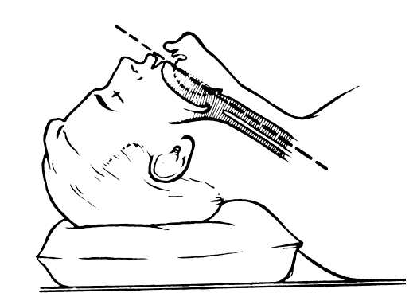
An optimal position of head to insert catheter into trachea.
This position helps align the opening of the larynx with the lower pharynx, making catheter passage through the larynx more likely.

Slide 37
Continue to advance the catheter until the patient coughs, or a resistance is felt
Negative pressures should not exceed 150 mm Hg.
Withdraw the catheter with rotating motion
Duration of suctioning no more than 15 seconds.
Inserting suction catheter through the other nostril & follow same procedure.

Slide 38
ASSESSMENT OF OUTCOME
Effectiveness of NTS should be reflected by assessing patient post suction for
Improved breath sounds
Removal of secretions
Improved blood gas data or pulse-oximetry
Decreased work of breathing (decreased respiratory rate or dyspnea)

Slide 39
HAZARDS/COMPLICATIONS OF NTS
Mechanical trauma
Hypoxia/hypoxemia
Cardiac dysrhythmias/arrest
Bradycardia
Increase in blood pressure
Hypotension
Respiratory arrest
Uncontrolled coughing
Gagging/vomiting
Laryngospasm

Slide 40
Bronchoconstriction/bronchospasm
Discomfort and pain
Nosocomial infection
Atelectasis
Increased intracranial pressure (ICP)
  Intraventricular hemorrhage
  Exacerbation of cerebral edema
Pneumothorax

Slide 41
FREQUENCY
  Nasotracheal suctioning should be performed by a skilled caregiver when indicated and when other methods to remove secretions from airway have failed.
LIMITATIONS OF METHOD
  NTS is a blind procedure with inherent risks (refer to complications).
  Risks are increased in a combative or uncooperative patient.

Slide 42
TRACHEOSTOMY SUCTIONING
Opening into the trachea where an artificial (tracheostomy tube) is inserted.
To protect from accidently inhaling food, fluids or saliva.
Such an airway may be necessary for a patient when prolonged ventilation is required or in Weaning failure & Upper airway obstruction.

Slide 43
Tracheostomy care
Remove inner cannula prior to humidification and suctioning
Wash inner cannula with saline and hydrogen peroxide
Wet gauze pads for continuous humidification
Home care
Maintaining and ensuring a patent airway by suctioning is a vital component of management for a patient with a tracheostomy.

Slide 44
INDICATIONS
Audible secretions
Rise in peak inspiratory pressure
Increased airway resistance
Decreased dynamic compliance
Decreased tidal volume delivery during pressure limited ventilation
Decrement in ABG values or saturation
Unrelieved coughing and
Evidence of atelectasis on chest x-rays

Slide 45
Suctioning procedure for tracheostomy is same as for the endo-tracheal suctioning.
The tracheal tube should be handled carefully to avoid coughing and straining.

Slide 46
OROPHARYNGEAL & NASOPHARYNGEAL SUCTIONING
Oral suctioning is considered “ongoing monitoring” rather than an integral part of suctioning procedures.

Slide 47
INDICATION
For the removal of retained secretions unable to be expectorated by the patient themselves
Difficult in breathing due to excessive saliva.
Frothing bubbling or dribbling may be seen from the mouth which cannot be drained by changing posture.
To minimise the risk of infection

Slide 48
CONTRAINDICATIONS
There are no absolute contraindications but potential precautions/dangers are listed below;
PRECAUTIONS & DANGERS
Facial fractures
Loose teeth
Laryngeal / oral carcinoma
Severe bronchospasm
Stridor
Restless / anxious client
Do not attempt to remove a solid object or an inhaled foreign body from the back of the throat with suction.(Danger)

Slide 49
PROCEDURE FOR OROPHARYNGEAL SUCTIONING
Rigid (Yankauer) or flexible catheter.
If teeth are clenched, it may be possible to insert catheter laterally behind last molar or where teeth are missing.
Most fluids found in mouth and pharynx is not highly viscous and is easily removed.
Usually size 14-18 French catheters are used in adults.
Vacuum control on catheter should be open while inserting the catheter.

Slide 50
The catheter should be withdrawn slowly with a twisting motion while intermittently occluding the vacuum control.
Apply suction through the Yankauer for a short period of time (no longer than 10 seconds) as this might result in tissue grab causing damage to the sensitive lining of the mouth.
Repeat again if necessary.

Slide 51
Frequency of oropharyngeal suctioning
Based on this study’s findings, oropharyngeal suctioning should be done at least every 4 hours; however, the frequency should be determined by the patient’s status.

Slide 52
PROCEDURE FOR NASOPHARYNGEAL SUCTIONING
Collect the suction equipment
Discuss the procedure with the patient, reassure the patient
Position the patient for easy access and best result
Grasp the thumb control valve with unsterile hand and suction catheter by the sterile hand.
Check the vacuum pressure

Slide 53
Have the patient to take 6-7 deep breaths before the suctioning is performed
Insert the catheter into one nostril parallel to the hard palate
Occlude the thumb intermittently and withdraw the catheter
Repeat the procedure in the opposite nostril and the mouth
After the procedure the catheter is disconnected and disposed off
Assess the patient for any untoward effects.

Slide 54
CLOSED SUCTIONING
Introduction of the suction catheter into the airways without disconnecting the patient from the ventilator is known as closed suctioning.
INDICATIONS FOR USE OF CLOSED SUCTIONING TECHNIQUES
High ventilator requirements
Mechanically ventilated patients with active tuberculosis

Slide 55
Mechanically ventilated patients receiving frequent suctioning. (>6/days)
Hemodynamic instability associated with ventilator disconnection
Patients receiving inhaled agents that cannot be interrupted by ventilator disconnection (e.g. nitric oxide, helium/oxygen mixture)

Slide 56
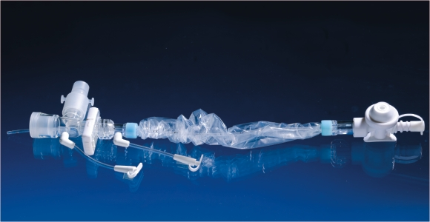
CLOSED SYSTEM SUCTION CATHETER
Modified T piece for ventilator support
Catheter sheath
Manual vacuum control
To vacuum source
Irrigation port for saline lavage or rinsing the catheter
Catheter

Slide 57
PROCEDURE FOR CLOSE SUCTIONING
Connect to the vacuum source to the catheter
Less like hood of hypoxemia (pre-oxygenation with 100% O₂ is still required).
Insert the catheter by using thumb and forefinger of the dominant hand while the non dominant hand stabilizes adaptor.

Slide 58
Apply suction by depressing the suction valve while withdrawing the catheter.
Keep total suction time less than 10 to 15 seconds.
The catheter and collar should be rinsed after each suctioning attempt by flushing saline into the injection port while depressing suction control valve.

Slide 59
Caution must be used to ensure the saline is being drawn into the catheter and not down the airway.
If residual secretions are still present, the closed suction system should be replaced.
Re-oxygenate and hyperinflate the patient at least 1 minute.
After use, the catheter should be disconnected from the vacuum source to avoid negative pressure being applied to the breathing system if the vacuum control valve is faulty.

Slide 60
MONITORING
    Breath sound
    Oxygen saturation (SpO₂)
    Respiratory rate and pattern
    Pulse rate, blood pressure, ECG(if indicated and available)
    Sputum (colour, volume, consistency, odour)
    Ventilator parameters
    Arterial blood gases
    Cough effort and ICP (if indicated and available)

Slide 61
ASSESSMENT OF OUTCOME
Improvement in breath sounds
Decreased Peak Inspiratory Pressure
Decreased airway resistance or increased dynamic compliance; increased tidal volume delivery during pressure-limited ventilation
Improvement in ABG values or saturation as reflected by pulse oximeter (SpO₂)
Removal of pulmonary secretions

Slide 62
CLOSED SUCTION | OPEN SUCTION
No need to discontinue ventilation or PEEP while suctioning | Require discontinuation
Usually hyperoxygenation not require prior to suction | Require hyperoxygenation
Fewer cardiovascular problem & less anxiety | Comparatively more
Less time consuming | More time consuming
Does not cause malfunction of mechanical ventilation | It may cause
More convenient | Less convenient
Oxygenation is superior | Less

Slide 63
Less contamination from accidental breaches to the catheter | More
Less nosocomial infection | More
Less contamination of the environment around the patient | More
Performed easily & quickly by one caregiver | At-least two person require for suctioning
Helpful in preventing the loss of lung volume & alveolar de-recruitment in severely hypoxic patient with ALI | Less effective than closed suctioning
Cost 10 times more than single disposable kit (depends on how long it used)

Slide 64
Disadvantages of closed system over open suctioning
Some author suggested Closed suctioning is not as effective in removing secretion as open suction .
Periodic use of open suction may be useful to increase secretion removal in patients with thick, tenacious secretions.
However, this increases costs and may result in loss of sterility associated with the closed system
Extra weight of closed system may pull on the airway, causing trauma or accidental extubation.

Slide 65
Some healthcare providers have complained that closed suctioning is more difficult to use, may cause more trauma.
Close suction without interrupting mechanical ventilation may impede the ventilator to efficiently assist the patient during ES, causing a major patient-ventilator dissynchrony and patient discomfort.

Slide 66
REFERENCES
Dorsch J, Dorsch S. Understanding anesthesia equipment. 5th ed. Lippincott: Williams & Wilkins; 2008.
Endotracheal suctioning of mechanically ventilated patients with artificial airways 2010. Respir Care 2010;55(6):758–64.
AARC clinical practice guideline nasotracheal suctioning—2004 revision & update. Respir Care 2004;49:1080-84.

Slide 67
Leyn P, Bedert L, Delcroi M, Depuydt P, Lauwe G, Sokolov Y, et al. Tracheotomy: clinical review and guidelines. Eur J Cardiothorac Surg 2007;32:412-421.
Maggiore S, Iacobone E, Zito G, Conti G, Antonelli M. Proietti R. Closed versus open suctioning techniques. Minerva Anestesiol 2002;68:360-4.
Wilkins R, Stoller J, Kacemarek R. Egan’s fundamental of respiratory care. 5th ed. Elsevier; 2008.

Slide 68


