Slide 1
Interstitial Lung Disease
Dr. Vaibhav Kapare
Dept. Of Cardiovascular & Respiratory Physiotherapy
MGM Institute Of Physiotherapy
Chh. Sambhajinagar

Slide 2
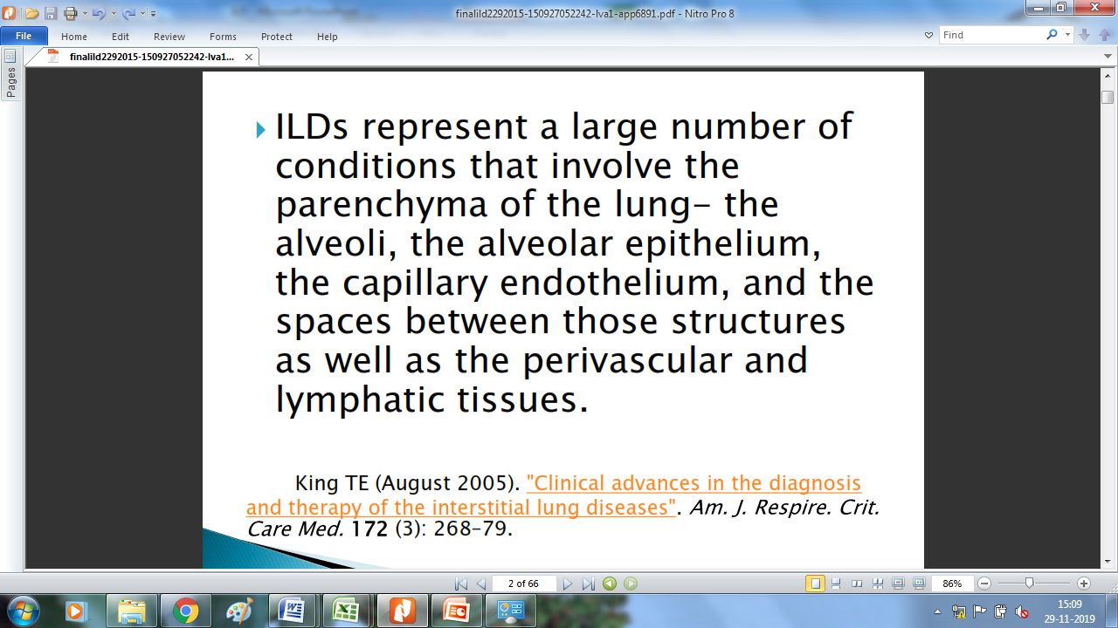

Slide 3
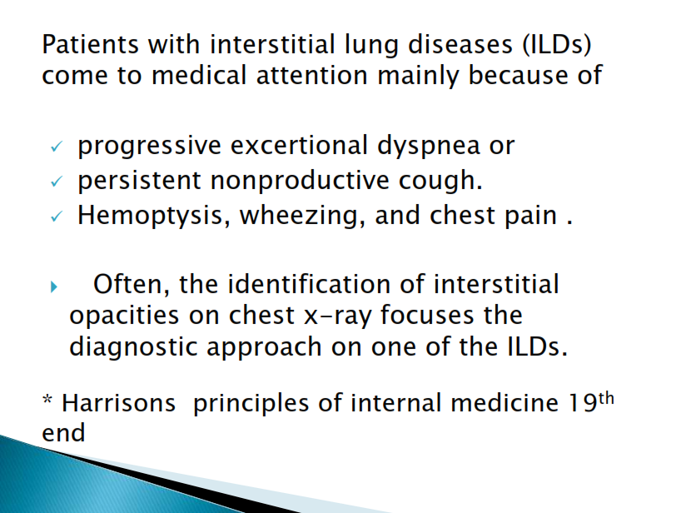

Slide 4
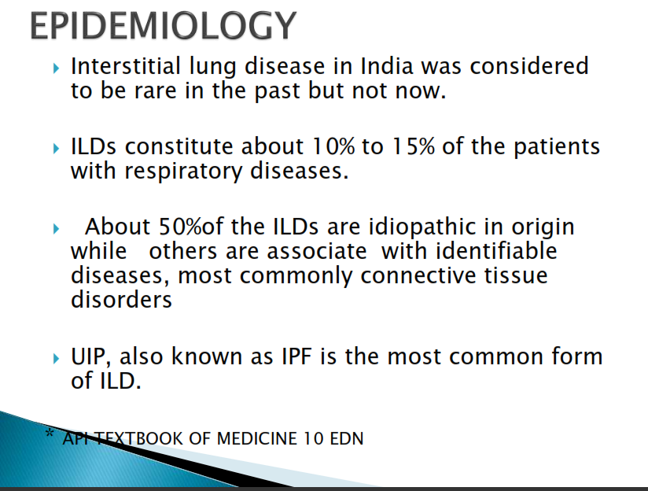
Notes:
Usual interstitial pneumonias

Slide 5
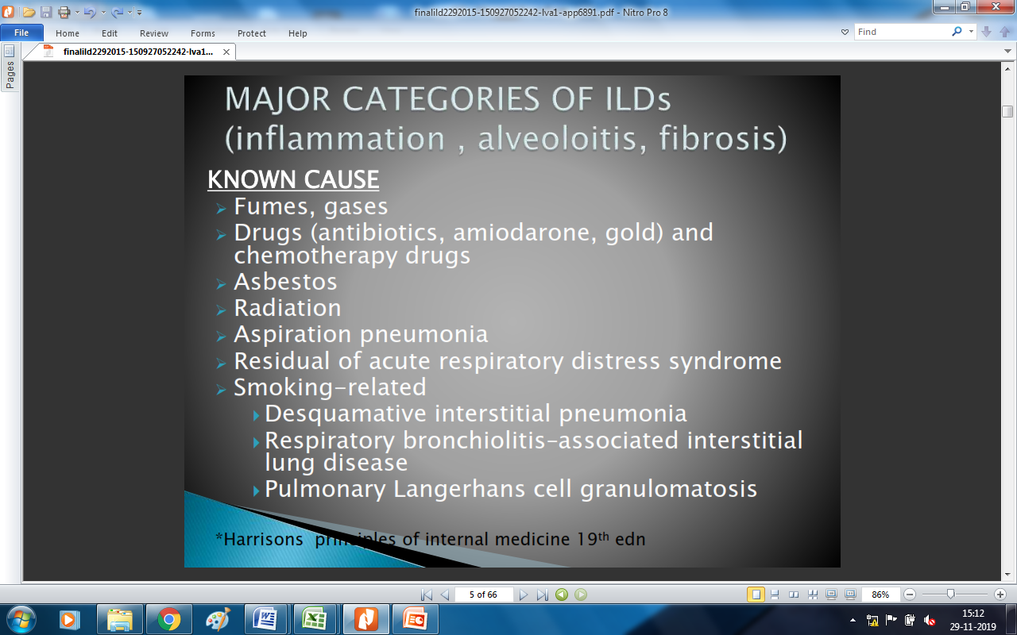
Notes:
Pulmonary Langerhans cell histiocytosis (PLCH) is proliferation of monoclonal Langerhans cells in lung interstitium and airspaces.

Slide 6
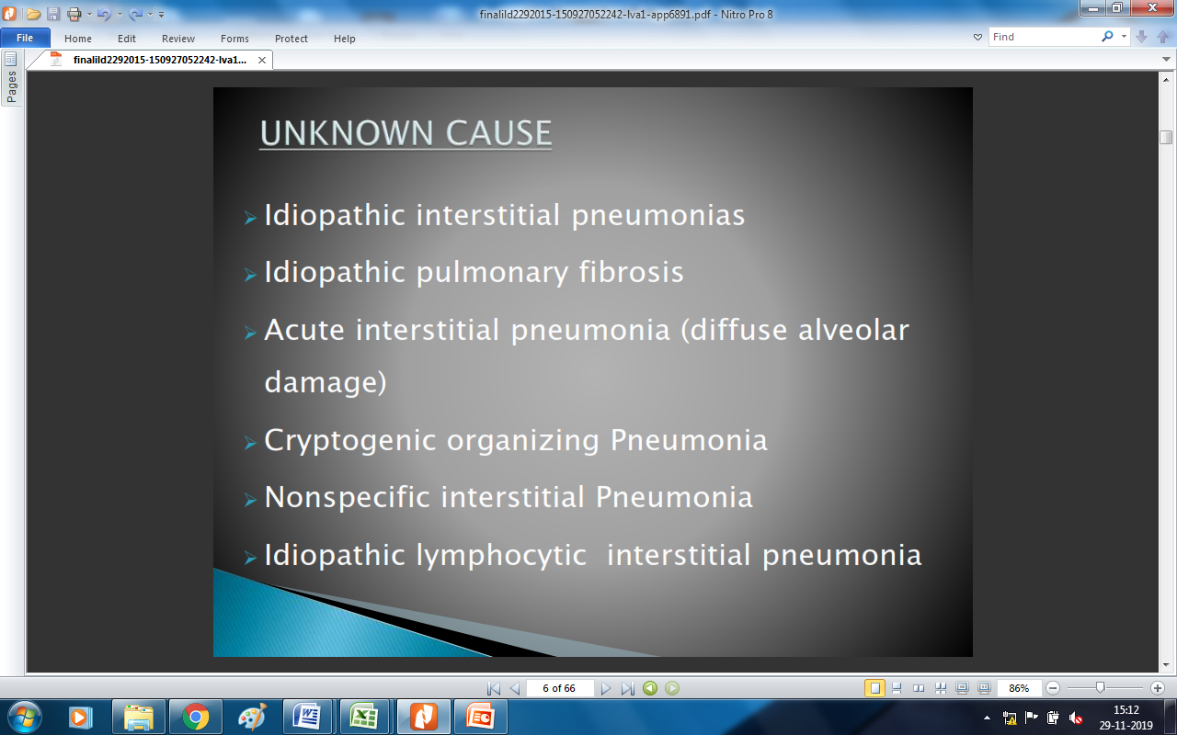
Notes:
Cryptogenic organizing pneumonia (COP) is a form of idiopathic interstitial pneumonia characterized by lung inflammation and scarring that obstructs the small airways and air sacs of the lungs (alveoli). Signs and symptoms may include flu-like symptoms such as cough, fever, malaise, fatigue and weight loss.

Slide 7
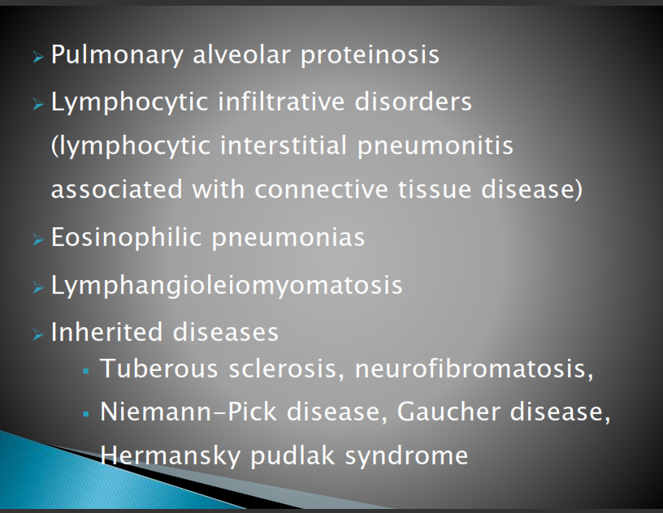
Notes:
Lymphangioleiomyomatosis (LAM) is an indolent, progressive growth of smooth muscle cells throughout the lungs, pulmonary blood vessels, lymphatics, and pleurae. It is rare and occurs exclusively in young women. Symptoms are dyspnea, cough, chest pain, and hemoptysis; spontaneous pneumothorax is common.
Niemann-Pick disease is an inherited disease that affects lipid metabolism, or the way fats, lipids, and cholesterol are stored in or removed from your body. People with Niemann-Pick disease have an abnormal lipid metabolism that causes a buildup of harmful amounts of lipids in various organs

Slide 8
Cryptogenic organizing pneumonia (COP) is a form of idiopathic interstitial pneumonia characterized by lung inflammation and scarring that obstructs the small airways and air sacs of the lungs (alveoli). Signs and symptoms may include flu-like symptoms such as cough, fever, malaise, fatigue and weight loss.
Lymphangioleiomyomatosis (LAM) is an indolent, progressive growth of smooth muscle cells throughout the lungs, pulmonary blood vessels, lymphatics, and pleurae. It is rare and occurs exclusively in young women.
Niemann-Pick disease is an inherited disease that affects lipid metabolism, or the way fats, lipids, and cholesterol are stored in or removed from your body.

Slide 9
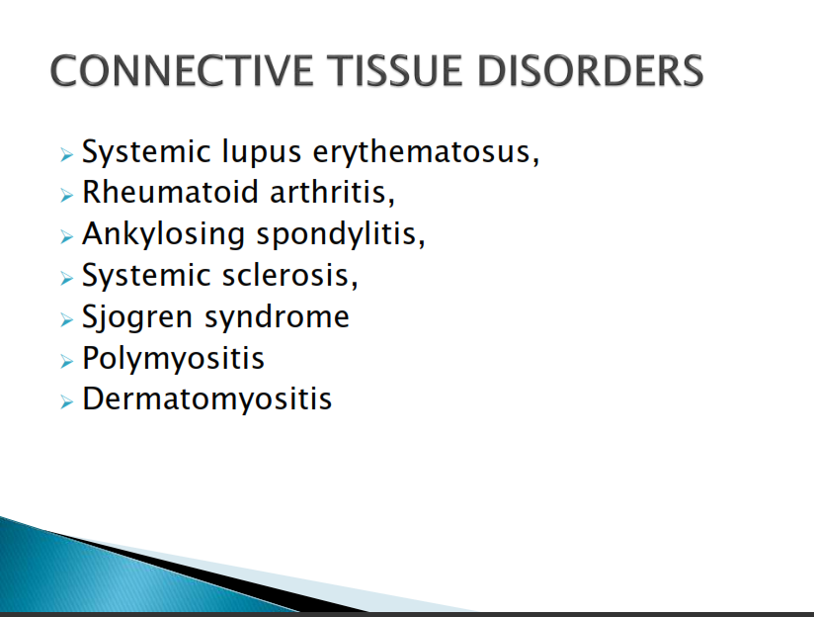
Notes:
Sjogren's (SHOW-grins) syndrome is a disorder of your immune system identified by its two most common symptoms — dry eyes and a dry mouth. The condition often accompanies other immune system disorders, such as rheumatoid arthritis and lupus.

Slide 10
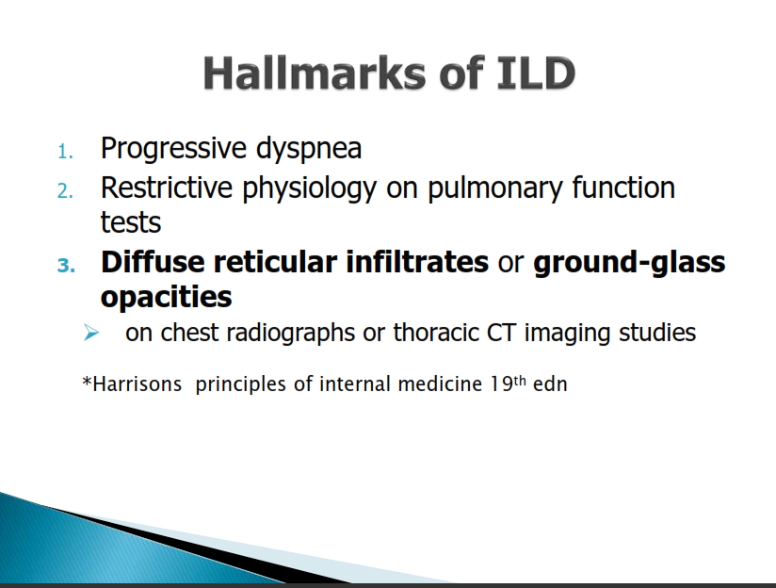

Slide 11
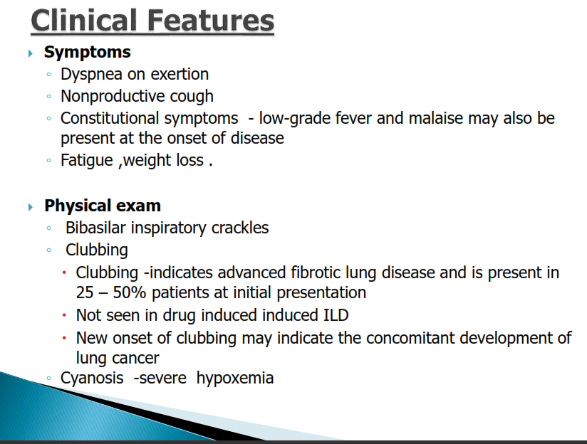

Slide 12
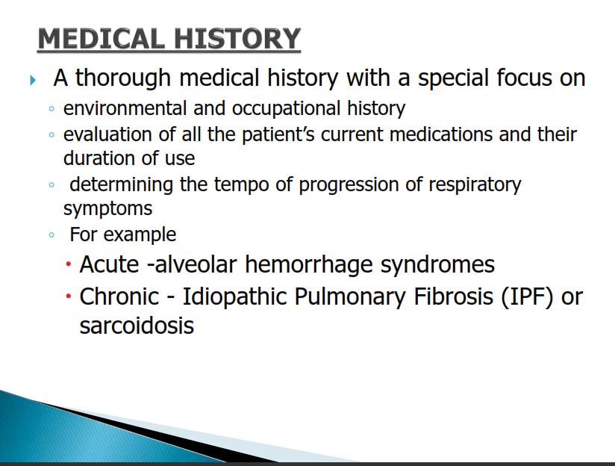

Slide 13
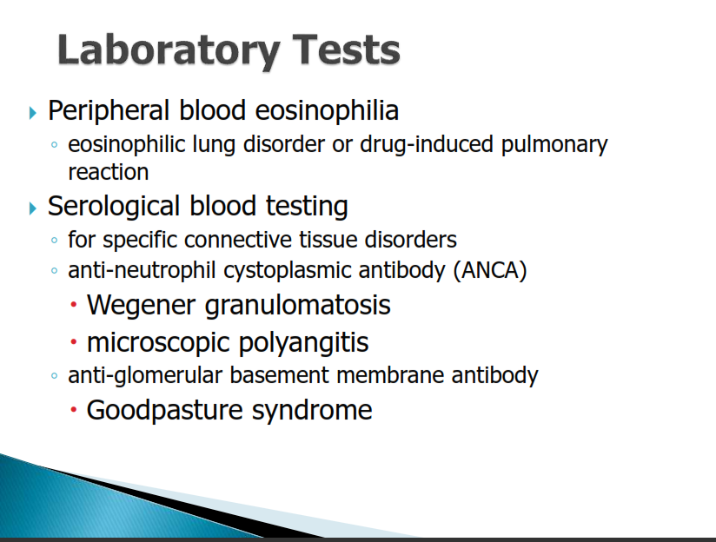
Notes:
Granulomatosis with polyangiitis is an uncommon disorder that causes inflammation of the blood vessels in your nose, sinuses, throat, lungs and kidneys. Formerly called Wegener's granulomatosis, this condition is one of a group of blood vessel disorders called vasculitis. It slows blood flow to some of your organs.15-Dec-2020
Microscopic polyangiitis (MPA) is a disorder that causes blood vessel inflammation (vasculitis), which can lead to organ damage. The kidneys, lungs, nerves, skin, and joints are the most commonly affected areas of the body.
Goodpasture syndrome (GPS), also known as anti-glomerular basement membrane disease, is a rare autoimmune disease in which antibodies attack the basement membrane in lungs and kidneys, leading to bleeding from the lungs, glomerulonephritis, and kidney failure.

Slide 14
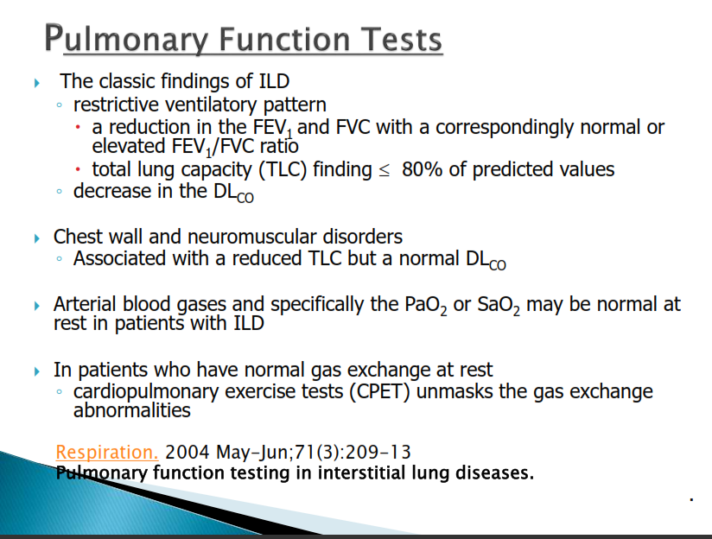

Slide 15
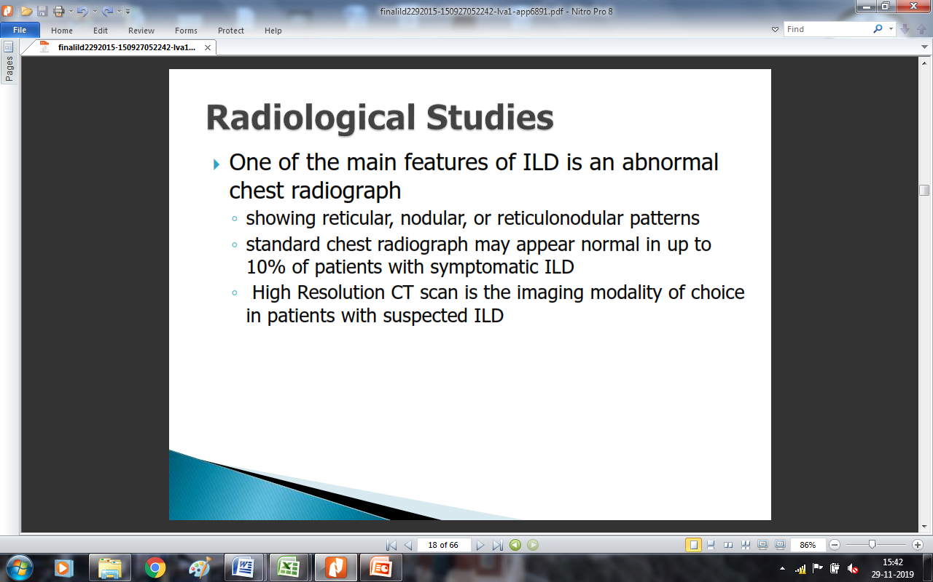
Fiberoptic Bronchoscopy

Slide 16
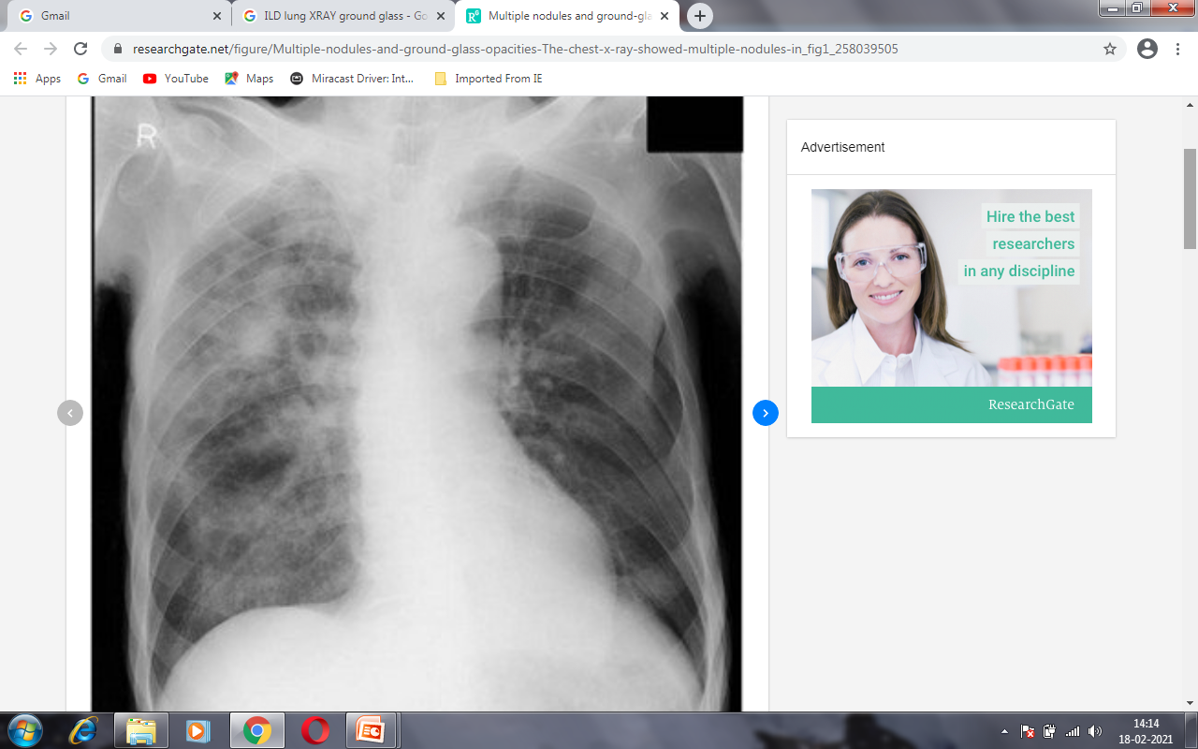
Chest X-Ray
Multiple nodules and ground-glass opacities. The chest x-ray showed multiple nodules in the right upper lung field, and mixed ground-glass and airspace opacities in the entire right lung.

Slide 17
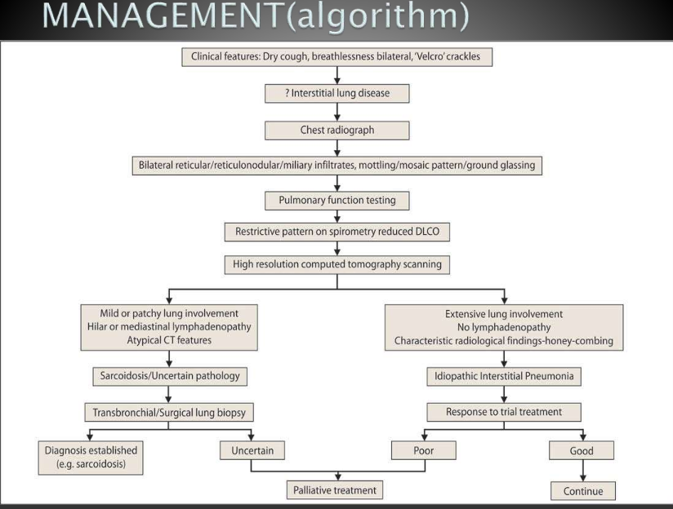

Slide 18
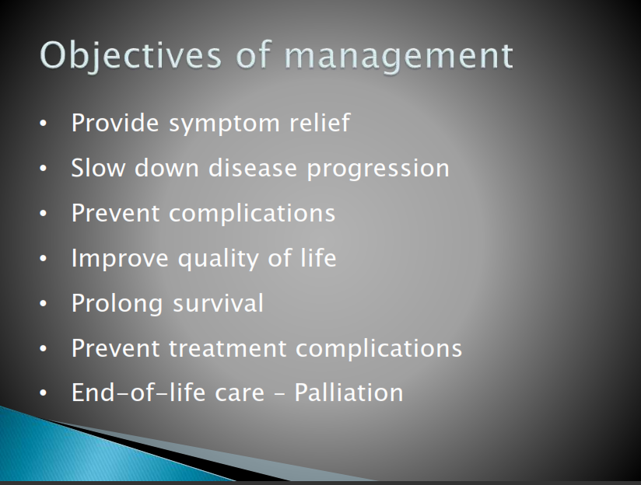

Slide 19
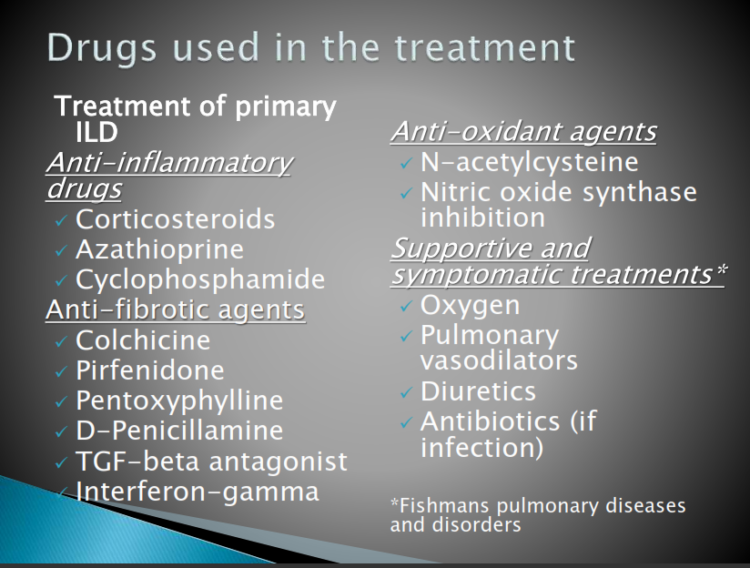

Slide 20
PT management
GOALS:-
To teach proper method of breathing pattern and effective coughing or huffing
To prevent accumulation of secretions
To mobilize and remove secretions
To give proper positioning to improve V/Q match
To mobilize the thorax and shoulder girdle and to teach the postural awareness
To teach relaxation
Improve functional capacity by exercise training program
Advice the home program

Slide 21
Thanks

Slide 23
